Slide 1
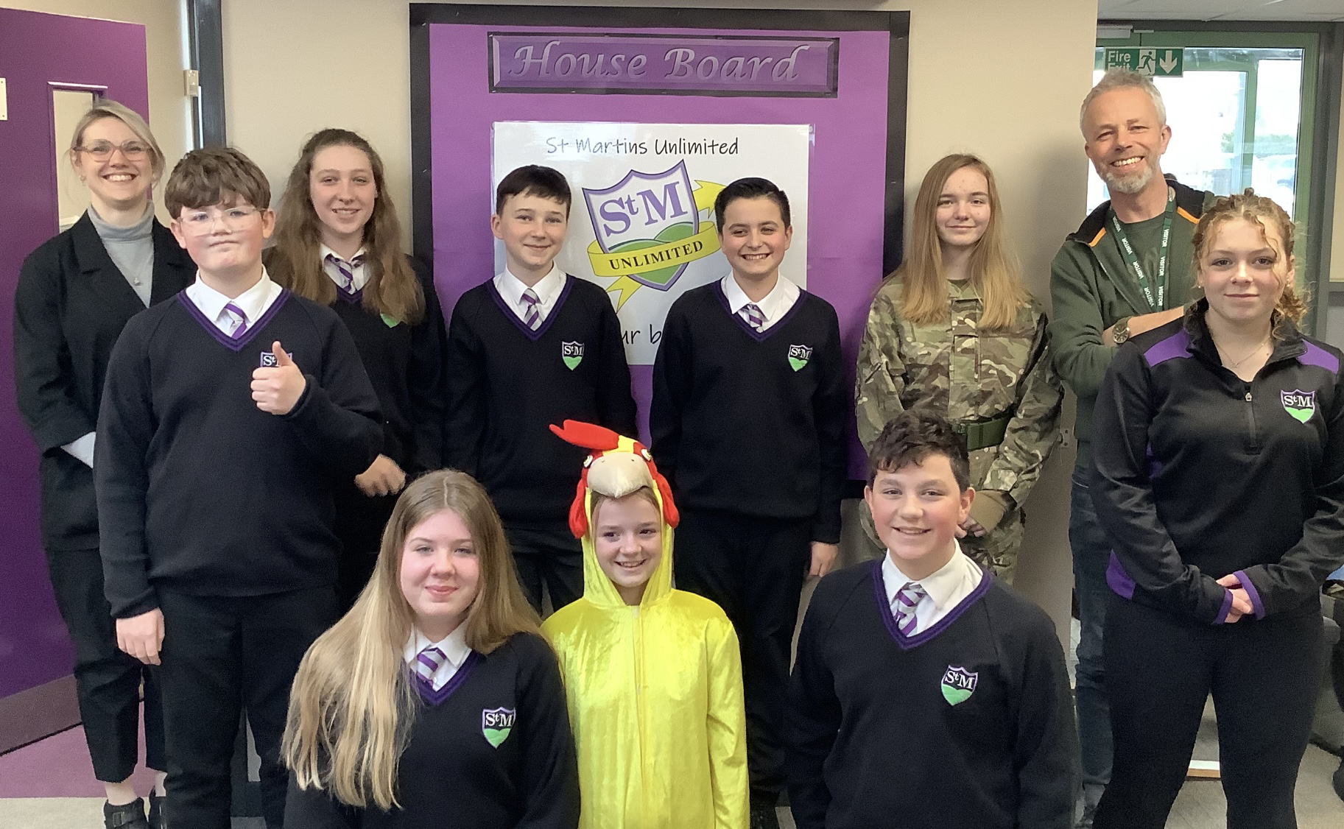
St.Martins Unlimited

Slide 2
Baking Unlimited
We sell the best and most delicious food in St Martins! 🍪
Our food is made from quality products 🍰
The next big event is the ‘Easter’. Sale taking place in the Hub in 31st of March, where you'll find mini eggs nests and easter egg sugar cookies.🐣

Slide 3
Gym Unlimited
Payment ?…💷
Run by Annabelle & Lyla 🏃‍♀️🏃‍♀️
It would be like a gym membership🪪
Date in process (after school)
In the Sports Hall💪

Slide 4
Growing Unlimited
Now in progress 📈
In the Future, we are going to use our grown products in our baking business and be selling them to the primary children 🥗

Slide 5
St. Martins Unlimited community
Marketing
Posters & Advertising🧩
Webpage
Organisation

