Slide 1
Year 11: Difficult is worth doing
St Martins School Autumn Term 2020
Notes:
KM/ZM narrate

Slide 2
This presentation aims to guide and support our students and families to prepare for GCSE
What needs to be happening outside of school?
Pupils
Parents and carers
What school can offer
Individualised support
Subject Intervention
Team Effort
How can we all work together?
Notes:
KM narrate

Slide 3
Where are we now?
Attitude to learning, behaviour and subject reports
Reflection of student's overall participation in individual subject levels.
3 and below are a concern
Long reports are due out
Target Levels
These are used by the school as benchmark for each student’s progress
The Department of Education set one grade for each subject and the school can tailors these based on progress students make.
Our estimated grades are based on these target grades and work produced during the course.
Notes:
Explain the importance of the estimate grades – ZM narrate

Slide 4
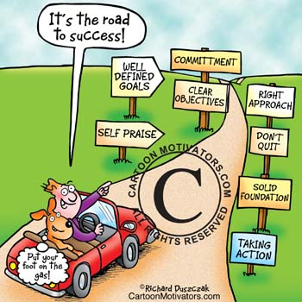
Notes:
KM narrate

Slide 5
In class revision materials to be given to complement package of materials online.
Feedback to questionnaire, if appropriate further support given .e.g zoom calls, meeting with staff etc.
Year 11 Preparation for success pack
Mock exam results & intervention where appropriate
10.12.20 onwards
W/C
14.12.20
4.01. 21 onwards
11.01.20-29.01.21
February 2021
10.12.20
18.12.20 – 5.01.21
21.03.17
22.01.17
Questionnaire completed by parents
Independent preparation at home
Year 11 Mock Exams
29.11.16
Notes:
ZM narrates

Slide 6
Intervention Options
We recognise that this may be more challenging to deliver; though the needs may be more acute than ever. We need to work very closely to ensure our pupils meet their potential.
Who will intervention be aimed at?
Individuals showing signs of difficulty coping with:
Stress
Workload
Focus in class
Completion of independent work to target level standard
Subject Intervention
Meeting with teacher and/or subject leader.
Subject report
Tutor report
Action plan with parents
Notes:
KM narrates

Slide 7
Work for success
Learn from your mistakes – the more you make the more you learn
Advice from the teacher – giving you feedback, tells you how to improve
Identify what skills are needed for the particular task so you can practice and get good at them
Practice and improve
Take responsibilty for your own learning
Organisation
In sport you haven’t got time to think about what stroke you are going to return the serve, so you have to train your reflexes so it is done automatically, but this reflex has to be trained
Notes:
ZM narrate

Slide 8
Time Management
Prioritise using to do lists – do the most important things first; each day create a list of five things that you need to finish that day; go through your list and see which is the most important
Stop time wasting – think of the consequences of studying at the last minute; ask yourself ‘Do I really want that to happen?’
Notes:
KM

Slide 9
Good results depend on what students do at home – starting from now.
Your support, encouragement and interest can make a spectacular difference to your child’s motivation and ability to cope with the academic and organisational demands of Year 11.
Notes:
KM

Slide 10
Do
Discuss with your child what will be involved in completing year 11 and what your role could be.
• Provide the environment necessary for success.
• Respond positively when they ask for help. Ask exactly how you can help and if you can’t help immediately, say when it’s convenient.
• Give plenty of praise and encouragement. Point out what they are good at.
Notes:
KM

Slide 11
Do
• Point out what they have done well if you look at their work. Don’t dwell on the errors - emphasise the positives.
• Keep them well supplied with food and drinks.
• Keep a low profile.
• Be prepared to listen when they want to talk about problems as everything becomes more emotional and heightened during year 11.
Notes:
KM

Slide 12
Don’t
• Make comparisons with brothers, sisters, friends and so on.
• Unintentionally add to their worries by constantly mentioning the exams or deadlines.
• Relate too much to when you were sitting exams at school or how you did your revision.
• Distract them unnecessarily.
• Expect them to study all the time as taking some time out to relax will have a positive effect on their work.
• Join in the general anxiety; be a picture of serene confidence.
Notes:
KM

Slide 13
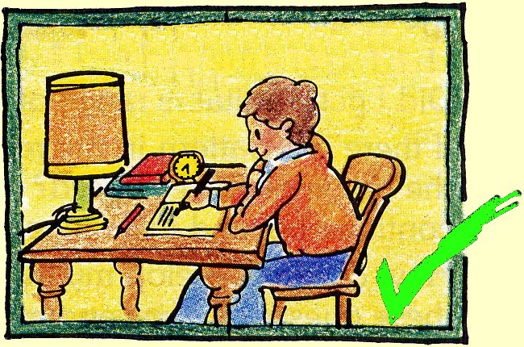
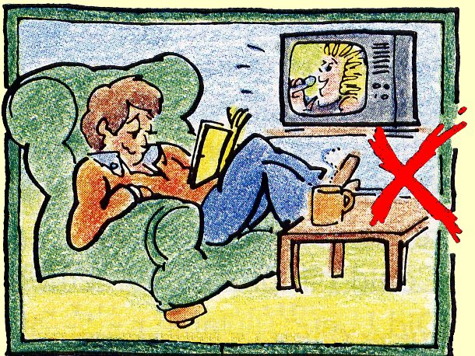
Study environment
Organised
Quiet
Not cluttered
Equipped with everything they need.
Free from interruptions
Notes:
ZM

Slide 14
Next steps
Take the time to read through and digest the materials made available to you
Mock exam timetable, success guide, Revision timetable, familise yourself with teams and resources shared on there
Please complete questionnaires this will enable to us to have an informed response as to how well prepared you as parents feel as we enter this important stage of Year 11
Please let us know if you have any additional questions or require further support
Student Engagement Students need to act on advice given
School Monitoring Dependent on individual pupil needs
Monitoring at home To check on student progress.
Notes:
ZM

Slide 15
Top tips for after this meeting
Practise exam questions
Be healthy
Feel the fear and get on with it!
Go public – don’t be stressing in silence
Don’t just sit there
Suffer a bit – you should expect that it will be tough; that’s ok
Notes:
KM

Slide 16
Remember
Change is necessary for success.
Manage your time.
Take the support on offer.
It is a TEAM effort
Contact:
katherine.mooney@stmartins3-16.org
zoe.mottershaw@stmartins3-16.org
Notes:
KM

