Slide 1
GCSE PE Edexcel (1-9) Course Information
This course starts in September of year 10 and is completed in May of Year 11
Students will learn the course content of 6 units through well planned differentiated tasks. Their knowledge will be assessed throughout each unit in a form of end of topic tests. Each student will received in depth feedback on how to improve their understanding.
Formal assessment:
- 2 exams in May of Year 11 which includes a range of work from years 10 and 11.
1 Practical Assessment in Year 11. Each student will select 3 sports (1 individual sport, 1 team sport and 1 team OR individual sport) from a set list of sports given by Edexcel where they will be assessed against a criteria.
1 coursework: Personal Exercise Programme (PEP) A 6 week training programme.

Slide 2
What will the students be learning?
This GCSE in Physical Education will equip students with the knowledge, understanding, skills and values they need to be able to develop and maintain their performance in physical activities. Students will also gain understanding of how physical activities benefit health, fitness and well-being.
The aims and objectives of this qualification are to enable students to:
● develop theoretical knowledge and understanding of the factors that underpin physical activity and sport and use this knowledge and understanding to improve performance
● understand how the physiological and psychological state affects performance in physical activity and sport
● perform effectively in different physical activities by developing skills and techniques and selecting and using tactics, strategies and/or compositional ideas
● develop their ability to analyse and evaluate to improve performance in physical activity and sport
● understand the contribution that physical activity and sport make to health, fitness and well-being
● understand the key socio-cultural influences that can affect people’s involvement in physical activity and sport.

Slide 3
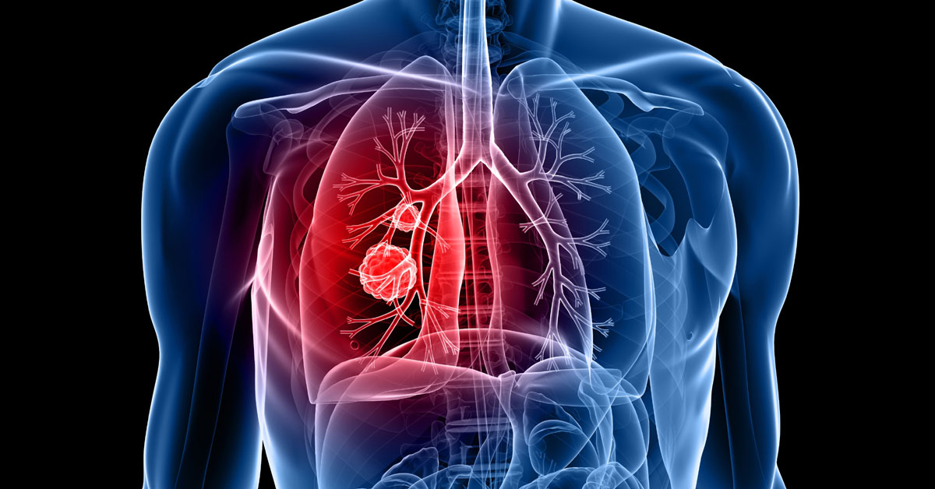
GCSE Physical Education Units of work for September 2017
Unit 1: Applied anatomy and physiology
Unit 2: Movement Analysis
Unit 3: Physical Training
Unit 4: Health, fitness and wellbeing

Slide 4
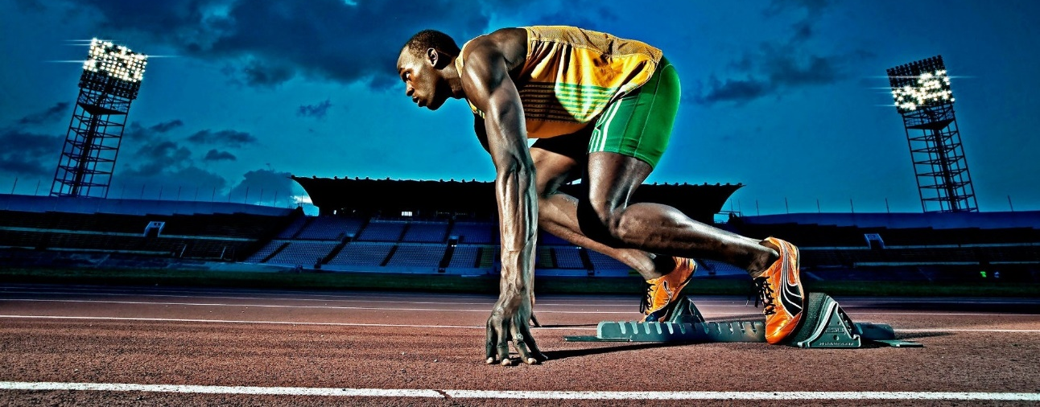
Unit 5: Sport Psychology
Unit 6: Socio-cultural influences
Unit 7: Practical performance and Personal Exercise Programme (PEP)

Slide 6
GCSE PE exam papers- also refer the topic mind map
Paper 1
Fitness and Body Systems
Paper 2
Health and Performance
Applied Anatomy and Physiology
(CV, Respiratory, skeletal, muscular systems)
Health fitness and well-being
Sport Psychology
Movement analysis
Use of data
(In both papers)
Physical training
Socio-cultural influences

