Slide 1
St Martins School
Year 6
Information for parents

Slide 2
Staff
This year Key stage will be taught in a team approach. Year 6 will be taught by the following staff
Mrs Pritchard
Mrs Young – French
Mr James – Music
Mr Machin – PE
Mrs Jones – Spellings, PSHE and RE

Slide 3
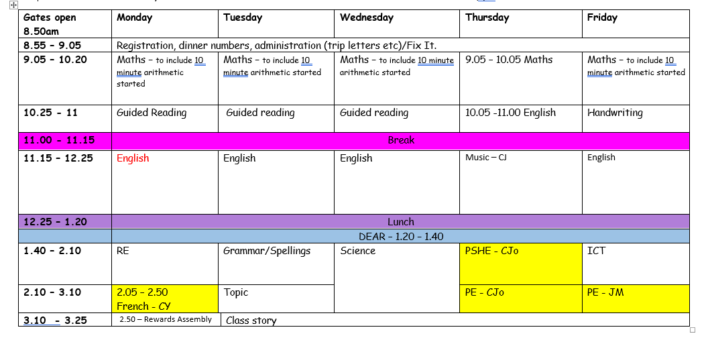

Slide 4
School Day
Gates open at 8.45, Year 6 pupils can come straight into class. Gates will close at 8.55 a.m
Break: 11.00 – 11.15
Lunch Year 12:25 – 1:20
Home time 3.25 pm

Slide 5

Attendance

Slide 6
Our expectations
Children are expected to attend school regularly and punctually.
Missing out on lessons leaves children vulnerable to falling behind. Children with poor attendance achieve less in both primary and secondary school.’
Our aim at St Martins School is for our whole school attendance to be in line with or above local and national figures.
An attendance of 97% or higher is a realistic target which would allow our pupils to flourish in all aspects of their growth.
Schools that improve attendance, maintain high levels of attendance and minimise persistent absence all have a number of features in common.
They ‘Listen, understand, empathise and support – but do not tolerate’.

Slide 7
Absence procedures
Parents must contact the school as early as possible on the first day of their child’s absence and every subsequent day of absence – updating the school on their child’s condition and expected day of return.
You are kindly asked to contact school on 01691 776500, ideally by 8:30am if your child is not attending school.
School will send out an absence email should contact not have been made.
For pupils who are absent from school, in line with Shropshire policy, work will NOT be set for pupils to complete.
776500 ideally before 8.30am with a reason for absence.
A daily phone call or text message is sent to the parent/carer if they have not reported their child’s absence.
If contact cannot be made with parent/carer, a home visit may be carried out by the Wellbeing, Attendance and Intervention Coordinator and other agencies may be informed where necessary.
In the case of regular absence or continued absence, medical evidence for proof of absence may be requested. This evidence may include:
GP appointment card (name/date/time clearly stated)
Prescription
Medical packaging with name of child on.
Medication.
Hospital letter/appointment letter.
Arrangements will be made for parents/carers to meet with Mrs Buka, our Wellbeing, Attendance and Intervention Coordinator in school and an attendance support plan may be initiated. In addition, an Early Help Assessment (EHA) will be offered, which can provide additional support that may be necessary to ensure regular attendance of your child at school.

Slide 8
Lateness
Punctuality is of very important and lateness will not be tolerated.
The gate to Primary is opened for pupils to enter school and be ready for learning at 8.45am and is then locked at 8.55am.
Pupils reaching school outside of this time will need to enter and sign in at the main reception.
Unauthorised lateness after schools registration has closed will receive a code ‘U’ to indicate that the pupil is in school after arriving late, this will count as an absent mark.

Slide 9
appointments
As far as possible, parents/carers should attempt to book medical and dental appointments outside of school hours. Where this is not possible, appointments cards or letters should be brought to school to enable authorisation of absence.
If the appointment requires the pupil to leave during the school day, they must be signed out by a parent/carer and signed back in on their return.
Pupils must attend school before and after the appointment where possible.

Slide 10
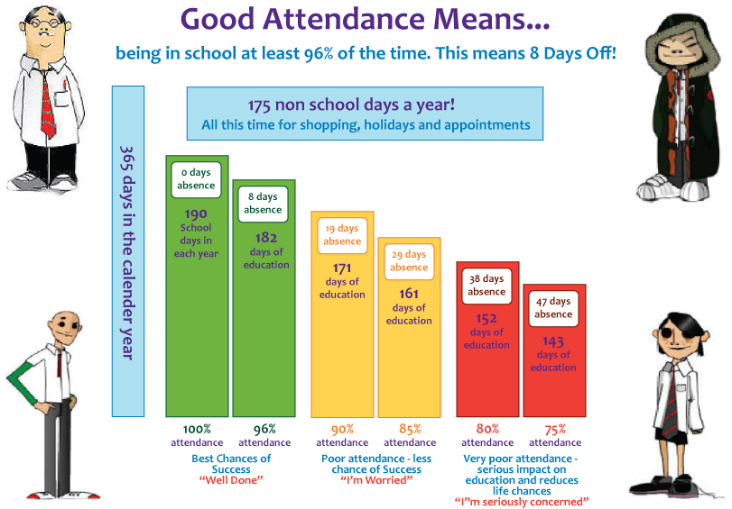
Good attendance means…
being in school at least 96% of the time; no more than 8 days off.

Slide 11
Regular absence
Our target attendance within school is 96%.
Should an individual child’s attendance fall below this level staff will invite parents/carers into school to discuss how we can support you/your child in improving levels of attendance.
The Educational Welfare Officer will also be monitoring attendance and will offer additional support in this area.
776500 ideally before 8.30am with a reason for absence.
A daily phone call or text message is sent to the parent/carer if they have not reported their child’s absence.
If contact cannot be made with parent/carer, a home visit may be carried out by the Wellbeing, Attendance and Intervention Coordinator and other agencies may be informed where necessary.
In the case of regular absence or continued absence, medical evidence for proof of absence may be requested. This evidence may include:
GP appointment card (name/date/time clearly stated)
Prescription
Medical packaging with name of child on.
Medication.
Hospital letter/appointment letter.
Arrangements will be made for parents/carers to meet with Mrs Buka, our Wellbeing, Attendance and Intervention Coordinator in school and an attendance support plan may be initiated. In addition, an Early Help Assessment (EHA) will be offered, which can provide additional support that may be necessary to ensure regular attendance of your child at school.

Slide 12
Regular absence
In the case of regular absence or continued absence or attendance which falls below expectations, medical evidence for proof of absence may be requested. This evidence may include:
GP appointment card (name/date/time clearly stated)
Prescription
Medical packaging with name of child on.
Medication.
Hospital letter/appointment letter.
Arrangements will be made for parents/carers to meet with their class teacher or a member of the Student Support Services team to support pupils in improving their attendance.
776500 ideally before 8.30am with a reason for absence.
A daily phone call or text message is sent to the parent/carer if they have not reported their child’s absence.
If contact cannot be made with parent/carer, a home visit may be carried out by the Wellbeing, Attendance and Intervention Coordinator and other agencies may be informed where necessary.
In the case of regular absence or continued absence, medical evidence for proof of absence may be requested. This evidence may include:
GP appointment card (name/date/time clearly stated)
Prescription
Medical packaging with name of child on.
Medication.
Hospital letter/appointment letter.
Arrangements will be made for parents/carers to meet with Mrs Buka, our Wellbeing, Attendance and Intervention Coordinator in school and an attendance support plan may be initiated. In addition, an Early Help Assessment (EHA) will be offered, which can provide additional support that may be necessary to ensure regular attendance of your child at school.

Slide 13
Uniform
All children should wear the correct school uniform of:
Purple Jumper/cardigan with or without the logo
A white polo shirt
Grey or black trousers Grey skirt or the new school skirt
Black shoes
No extreme hairstyle (tramlines etc..)
Girls should have their hair tied back, if it is long enough
Children can wear stud earrings – no loops etc

Slide 14
Curriculum
Each term there will be a topic overview which will be available on our school website.
We follow the National Curriculum set out by the Government
This term our curriculum will have a Geography focus, we will be studying world climate zones, biomes and how animals have become endangered.

Slide 15
P.E
Your child’s P.E lessons will be taught by Mr Machin and Mrs Jones.
They will have P.E on Thursday and Friday.
It is important that your child arrives in a P.E kit on their PE day. We will be going out in all weather so appropriate footwear and clothing is needed
P.E kit should be: a purple or white t-shirt, black shorts (jogging bottoms in winter), black pumps or trainers. A pair of football boots would also be useful.

Slide 16
Homework
The expectation id that Year 6 pupils complete at least 30 minutes of homework each day
As part of our homework policy your child will bring home spellings each week. These will be put onto SMHW each Wednesday. Maths homework will be set on a Monday and Grammar homework on a Friday.
Reading – at least 15 minutes per night - this can be any reading material. The wider the range of reading the better as this will prepare them for the SATs where they text focus could be on anything.
In addition to this children have the opportunity to complete homework based around our topic. These are non-compulsory but those children who do bring in pieces of homework receive house points and badges on their lanyards.

Slide 17
Reading
Reading to and with children – school reading books, library books, magazines. We love to see children reading every day.
Try to talk to children about their reading and their understanding of the texts. However, this should not impact upon reading for enjoyment.
The expectation is that children read as often as possible, ideally every day, and that they record what they have read in their Home School Diaries. We understand that as the children are older, they may not be reading daily with an adult, however we would like to see the diary signed by an adult
We want children to be reading for pleasure at home.
It is important that children are reading the appropriate books. Some children enjoy the challenge of a larger text however if they are not following the story then it is pointless. We encourage you to talk to your children about their books as well as listen to them read.
Reading is vital in all areas of education ( including maths).  Children need to make sure they have a reading book with them everyday at school.

Slide 18
Independence
Now that your child is at the end of Key Stage 2 it is important that they are independent and responsible for their own things. This is all to prepare them for secondary where they need to be carrying around their own equipment.
Try to encourage your child to remember their own equipment e.g. book bag, reading book, water bottle etc.
In class the children will be encouraged to be independent with their work, selecting equipment or resources that they think will help them

Slide 19
Drinks
Children need to bring a water bottle to school with them every day. The children are allowed bottles in the classroom but these ones just need to have water in please.
Snacks
At breaktime we are encouraging all children to eat a healthy snack - fruit. We have recently launched our fruit bar where children can purchase a piece of fruit for 15p. Sorry no cereal bars at breaktimes!

Slide 20
SATs
I will be offering more detail about the SATs test later on in the year
In the meantime, children will be provided with a login for SATSBootcamp. This will give them opportunities to practise past papers and revise key areas of the curriculum
As I tell the children SATs are something that I have to worry about and as long as they try their best then we will be proud of them.

Slide 21
SMHW
This year we will be using Show my homework in a slightly different way. As well as using it to set homework we will also be using it to record our house points.
This points will be added to your child’s profile and a notification will be sent to you as parents. We are hoping that this will increase the positive talk between home and school and that as parents, you are more aware of when your child s working well within school.

Slide 22
How to help your child.
• Ensure your child has the best possible attendance at school.
• Support your child with any homework tasks.
• Reading, spelling and arithmetic (e.g. times tables) are always good to practise.
• Talk to your child about what they have learnt at school and what book(s) they are reading (the character, the plot, their opinion).
• Make sure your child has a good sleep and healthy breakfast every day!

Slide 23
• Practise and learn weekly spelling lists – make it fun!
• Encourage opportunities for writing such as letters to family or friends, shopping lists, notes or reminders, stories and poems.
• Encourage use of a dictionary to check spelling and a thesaurus to find synonyms and expand vocabulary.
• Remember that good readers become good writers! Identify good writing features when reading (e.g. vocabulary, sentence structure and punctuation).
• Show your appreciation: praise and encourage, even for small successes!
• Play times tables games.
• Play mental maths games including counting in different amounts, forwards and backwards.
• Encourage opportunities for telling the time.
• Encourage opportunities for counting coins and money; finding amounts or calculating change when shopping.
• Play games involving numbers or logic, such as dominoes, card games, darts, draughts and chess.

