Slide 1
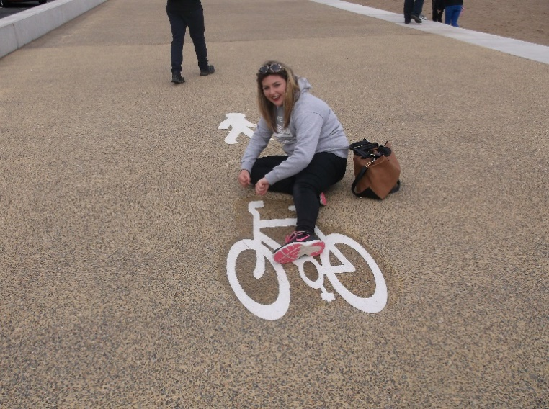
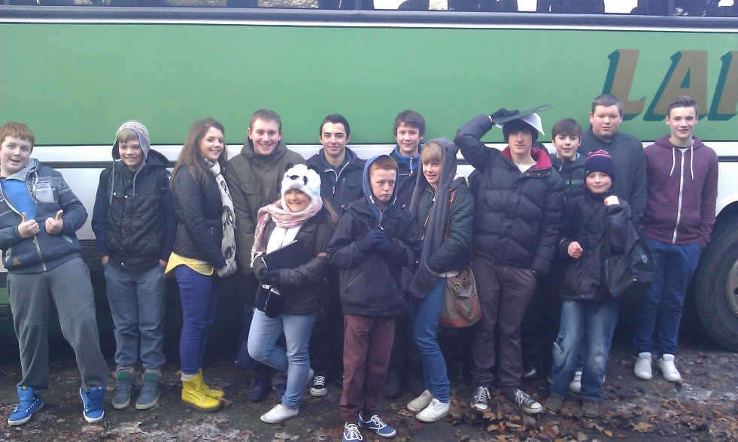
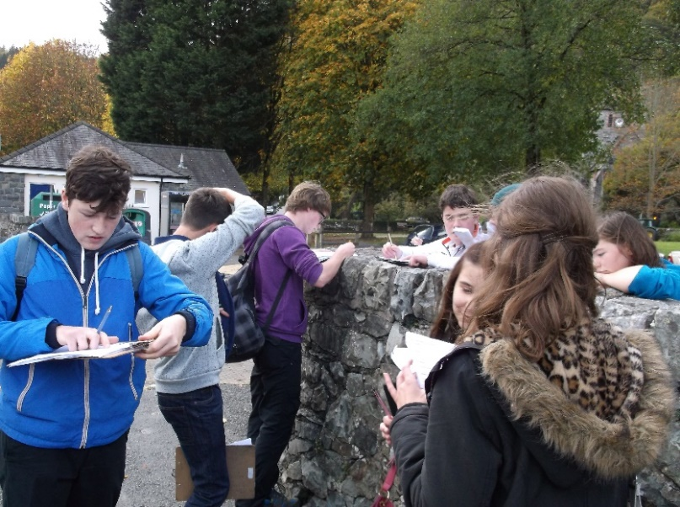
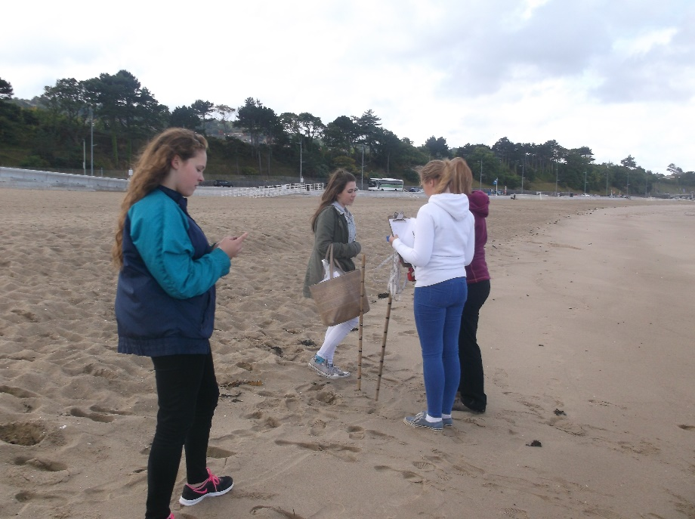
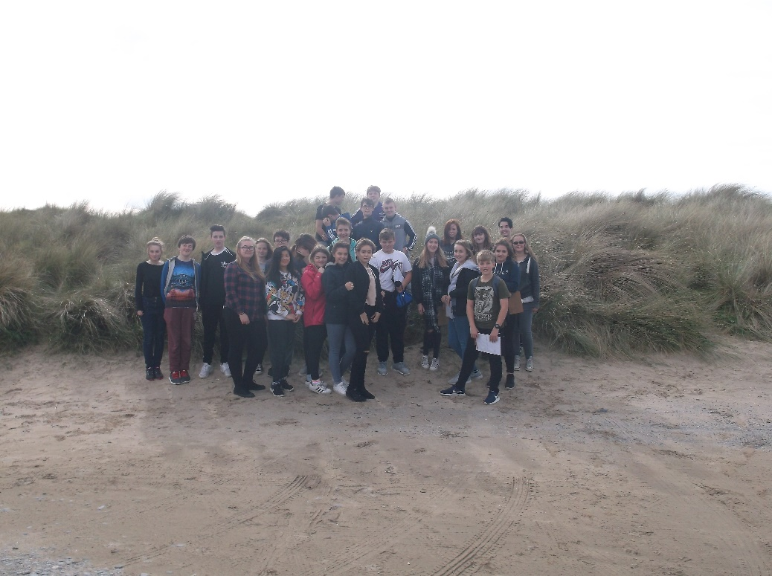

Welcome to GCSE Geography!

Slide 2
WJEC GCSE Geography A (9-1)
Component 1: Changing Physical and Human Landscapes (1 hour 30 minutes – 35%)
Section A: Theme 1 and Theme 2
Section B:Theme 3
Component 2: Environmental and Development Issues (1 hour 30mins -35%)
Section A: Theme 5 and 6
Section B: Theme 7
Component 3: Applied fieldwork enquiry (1 hour 30 mins – 30%)
Part A, B and C.

Slide 3
What we will cover
Theme 1 – Landscapes and Physical Processes
Theme 2 – Rural-urban Links
Theme 3-Tectonic Landscapes and Hazards
Theme 5 – Weather, Climate and Ecosystems
Theme 6 – Development and Resource Issues
Theme 7 - Social Development Issues

Slide 4
Fieldwork
Methodological approach
Conceptual framework
Geographical flows
We will be looking at changes within either a river or a coastal environment (sand dunes)
Sustainability
The plan is to look at the sustainability of the Chester Christmas markets

Slide 5
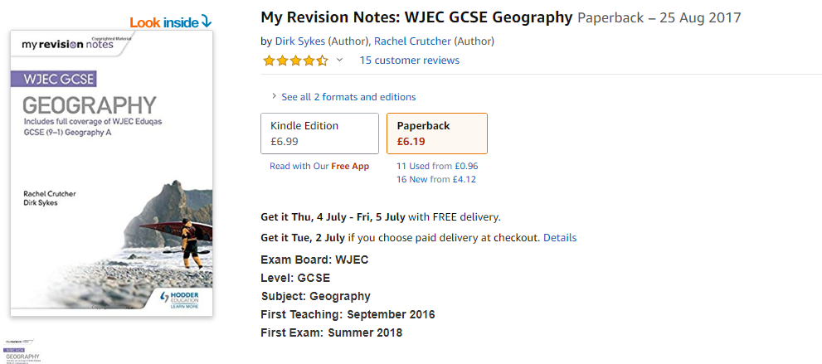
Two things to invest in

Slide 6
