Slide 1


Why study Enterprise and Marketing ?
You may want to start your own business
You may want to learn about how businesses work so you can work within a business environment or for someone else
You may want top progress in an area within enterprise and marketing and want to build on your own personal knowledge

Slide 2

Enterprise and Marketing
STRUCTURE
There are three mandatory units
One written exam R067 – 40% this has to be taken in year 11
Two pieces of coursework R068 & R069 – 60% which will be taken in year ten and 11
GRADING
Level 2 – Distinction* (*2), Distinction (D2), Merit (M2), Pass (P2)
Level 1 – Distinction (D1), Merit (M1), Pass (P1) and Unclassified.

Slide 3
What you will learn
How to apply real life business techniques to understand your customers and develop a product
Find out about business types and entrepreneurs- their skills
How to research potential customers, present data and act on feedback
Research and design your own business proposal – complete with facts and figures
How to work out costings, apply pricing strategies, see the financial viability of your product- how much do you have to sell to break even? What do you have to do to make a profit?
How to develop a brand identity and promote your product
Prepare a business proposal and pitching your idea
How businesses attract and keep their customers

Slide 4

Enterprise and Marketing – next steps
A Level Business, a Cambridge Technical in Business, a T Level in Digital Business, or an apprenticeship before starting university or work.
Careers in Business could take you anywhere – from working in top city offices, understanding businesses you work for to launching your own business and being an entrepreneur.

Slide 5
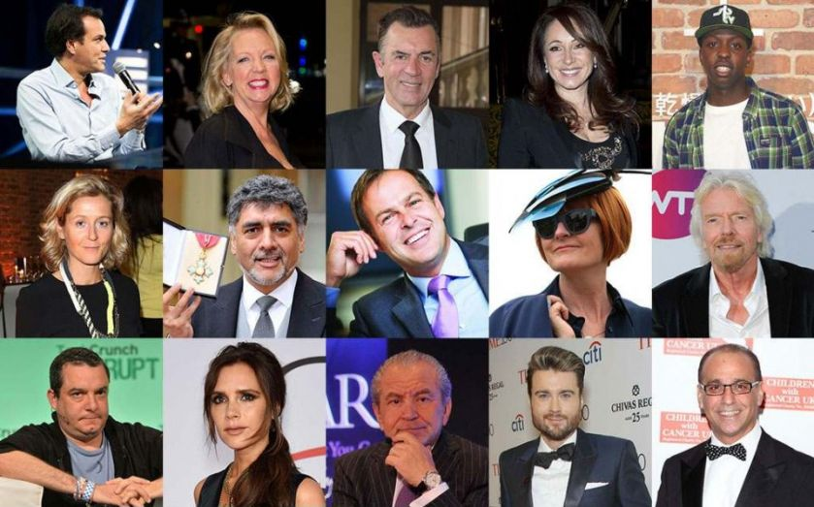
R067: Enterprise and marketing concepts - exam
Topics include:
Characteristics of an Entrepreneur
Risk and reward for an enterprise
Market research- types of research, methods of research, types of data, the benefits of market segmentation and customer profiles
Financial viability / profitability- you will look at the cost- of producing the product, revenue generated, profit/loss, break-even as an aid for pricing and costings plus the importance of cash
Marketing mix- elements of product and or service, how elements of marketing mix work together (Product, price, place, promotion) sales promotions, public relations, customer service, product lifecycle, extension strategies, factors to consider when pricing to attract and retain customers, pricing strategies
Starting and running an enterprise- types of ownership, sources of capital for start up and growth, support available for enterprises
Examination: 1 hour 15 minutes
40% of the Course

Slide 6

R068: Design a business proposal – coursework (This uses many of the elements within the exam)
Topics include:
Selecting appropriate primary and secondary research and sampling methods you will use
Complete and interpret market research findings
Identify a customer profile
Develop a product proposal- create a design mix for your new product, produce some designs, review these and complete a final design with an evaluation
Review the financial viability of the product- looking at costs, revenue, break even and profit of your product; deciding on pricing strategies to use to be effective
Review likely success of the new product
OCR set assignment – Coursework
30% of the Course

Slide 7

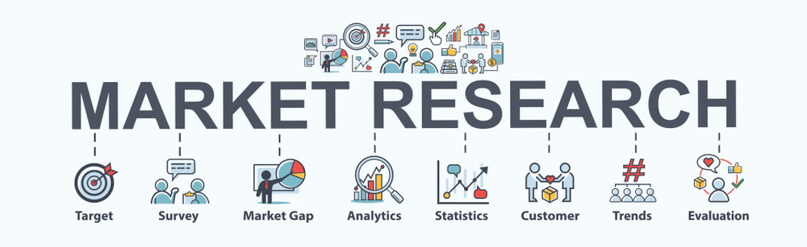
R069: Market and pitch a business proposal – coursework (Dragon’s Den style)
This follows on from R068
Topics include:
Develop a brand identity- what is a brand and why are they used, look at branding methods, key factors when researching competitors and identifying opportunities and threats in the outside world
Create a promotional campaign- explain the objectives- how you will get noticed, what makes you different, what timescales will you use and how successful do you think you will be? What promotional material will you use?
Complete a practice pitch- work on presentation, personal and communication; review your performance with feedback form others then adjust your presentation.
Deliver a professional pitch to Ms Lovecy and someone different from me ☺
Review a brand time – how successful were you? What would you do differently- all businesses look at what makes them successful and how they can make changes to improve
OCR set assignment – Coursework
30% of the Course

Slide 8
Enterprise and Marketing (J837)
Any questions?
Ask me via an email:
Helen.crightonpoli@stm.318eductaion.co.uk

