Slide 1


Assessment and Reports at St Martins
Information for parents and carers

Slide 2
Questions to answer
Why do we assess our pupils?
How do we assess?
How are target grades created?
What does the school report mean?
What if the report shows my child is below target?

Slide 3
Why do we assess our pupils?
We want every child to make progress
Assessment allows our teachers to see what progress each child is making
It allows them to adapt what they are teaching, or plan interventions for identified children
We report to parents and carers to ensure that you are fully informed about the progress your child is making
The partnership between school and parents is vital in ensuring all children reach their potential

Slide 4
How do we assess our pupils?
Assessments are completed at the end of each unit of work
Pupil work is marked and graded, and at 3 fixed points in the year these marks are used to generate a Current Working at Grade based on GCSE criteria
The Current Working at Grade is compared against where the child should be at that point, to achieve their Target Grade,
At these points, teachers will also give each pupil an Attitude to Learning Grade, and a Behaviour Grade
This data is used by teachers to plan future teaching, by Senior Leaders to plan interventions, and shared with parents to support at home

Slide 5
How are target grades created?
Target Grades are created using the same formula that the DfE use to calculate the school’s performance measures
All pupils have a KS2 score for Reading and Maths from their Primary School (apart from pupils in year 9 and 10, where we have CAT scores instead)
We look at what the average GCSE score was for each combined score in last year’s GCSE results, for every subject
We use that average, along with knowledge of our pupils, to set a target that is aspirational but achievable
Our reporting system then creates a “flight path”, which tells us which grade they should be achieving at each data drop to achieve their target grade at the end of year 11

Slide 6
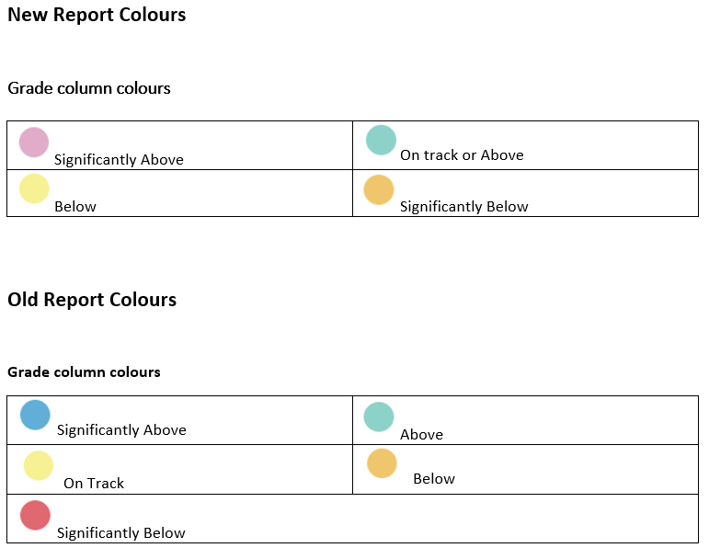
What does the school report mean?
The grade given is the GCSE grade your child would achieve if they were to sit the GCSE exam at that point in time.
The colour of the box shows if your child is working at the grade they should be working at for that point in their education.

Slide 7
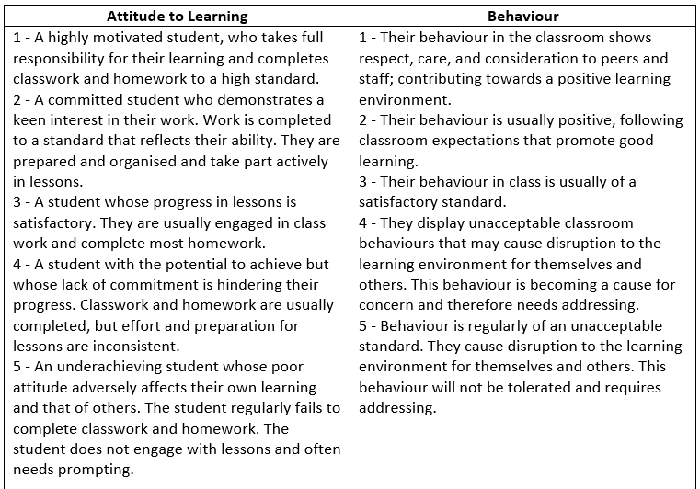

Slide 8
What if the report shows my child is below target?
Don’t panic!
The main reason for assessment is to allow the teachers to support children who are not making as much progress as they could
Speak to your child, do they know why they are not at their target grade? Do they know what they need to do, and what Golden Knowledge they need to learn, to get there?
If you are concerned, contact the specific subject teacher and ask them how you can support your child to improve their progress
If you think there is an error with the report, or the target grades, contact Mr Edwards to discuss
Children progress at different rates and in different ways, lots of children will get to their target grades in different ways. Just because a child is below target at a specific data point, does not mean they will not achieve their target grade in their final GCSE exams.

Slide 9
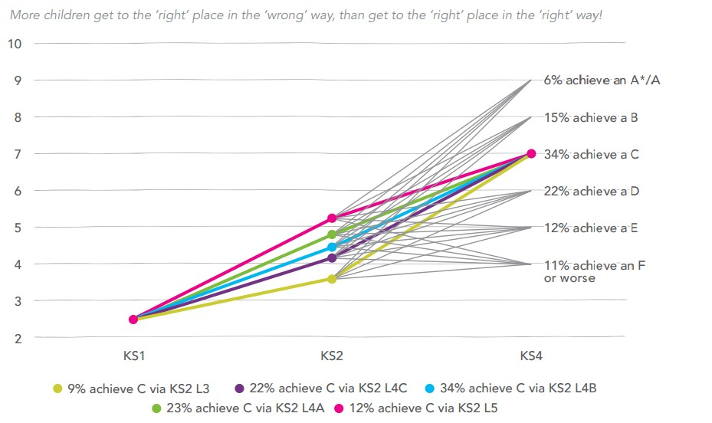

Slide 10
Any further questions?
We hope that we have covered all aspects of assessing and reporting to pupils
If you have any further questions regard reports, please email:
Chris.Edwards@stm.318education.co.uk

