Slide 1


GCSE Art Option
Exam Board: OCR Qualification: Art, Craft and Design (J170)

Slide 2
“Art is fun, and you learn a lot about colour and how to use it creatively.”
GCSE Art
What Students Say
“GCSE Art lets you explore your creativity, develop new skills, and have fun while learning.”
“I chose Art because I enjoy drawing and painting, and it allows me to try new techniques and ideas.”
“I like the freedom in GCSE Art. It’s different from lessons where you just sit and write, and you get to work independently.”
“GCSE Art gives you new experiences and helps you improve your skills over time.”
“Art can be very relaxing and enjoyable, but it’s important to keep up with the work you’re set.”
“I chose Art because I enjoy being creative. It’s fun, but you need to be willing to do some work at home too.”

Slide 3
January of Year 11 to Easter Component 02 40% of the overall GCSE grade
Externally set task: Students respond to one of five themes, each supported by a range of written and visual starting points and artists. Students produce a body of preparatory work to develop their ideas, which they then respond to during a ten-hour supervised period under exam conditions.
Overview: Our GCSE in Art and Design helps students develop the knowledge, skills, and understanding needed to express their creativity and imagination through responses to visual and written starting points.
Year 10 to Christmas of Year 11 Component 01 60% of the overall GCSE grade
Portfolio: Students produce a portfolio (sketchbook) of practical work that demonstrates their personal response to a given starting point. Our starting point is “Food and Drink”

Slide 4
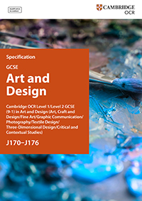
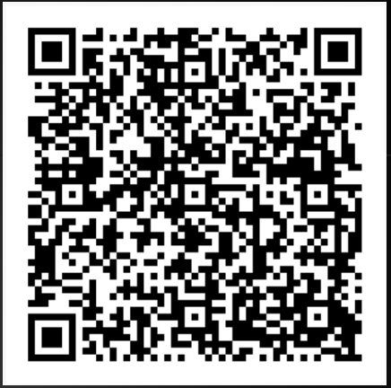
GCSE Specification

Slide 5
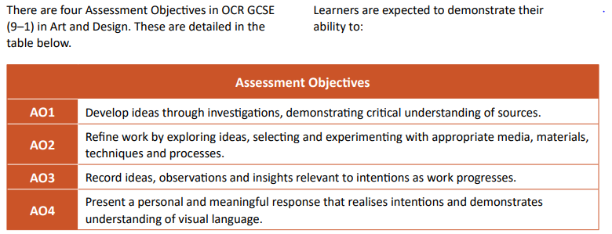
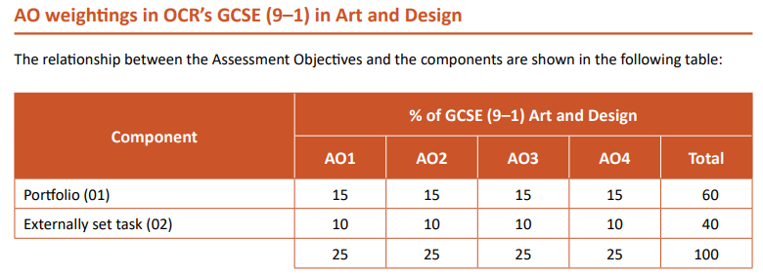
From the OCR GCSE Specification
How the work is assessed.

Slide 6
Students’ work in Art is assessed using four key areas (Assessment Objectives). Together, these show the journey a student takes from first ideas through to their outcome.
This is about quality over quantity.
AO1 Develop – Artist Research and Inspiration Students explore the work of artists and designers and show how these have inspired their own ideas. This might include looking at themes, styles, or techniques and explaining how these influences appear in their own artwork.
AO2 Refine– Ideas and Medias Students experiment with different materials and techniques, trying things out and making choices about what works best. They show how their ideas develop over time by refining and improving their work, and by gaining confidence and skill with the materials they use.
AO3 Record – Recording Ideas and Progress Students record their ideas and observations as they work. This can include drawings, photographs, written notes, and other evidence that shows how their ideas grow and change during the project.
AO4 Present – Final Outcome The final outcome shows a personal response to the project. This is not just about producing one finished piece, but about bringing together everything the student has learned and developed along the way. Good final outcomes clearly reflect the research, experimentation, and recording that came before, showing a complete and thoughtful creative journey.

Slide 7
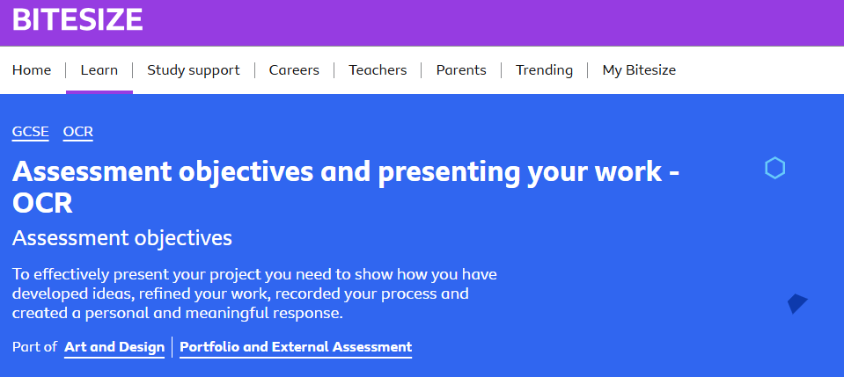
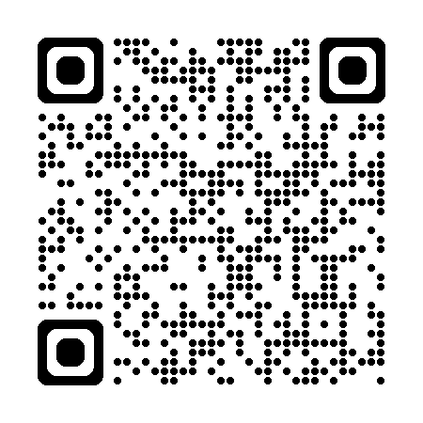
Assessment objectives - Assessment objectives and presenting your work - OCR - GCSE Art and Design Revision - OCR - BBC Bitesize

Slide 8
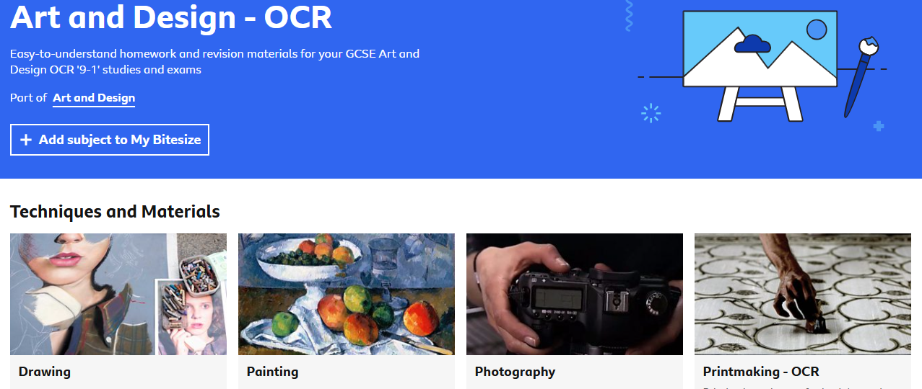
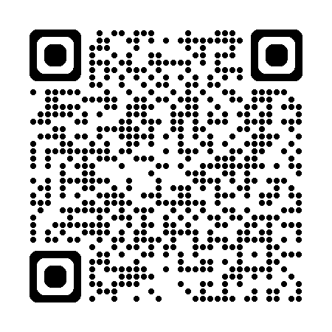
GCSE Art and Design - OCR - BBC Bitesize

Slide 9
Students will gain knowledge and experience in a wide range of art skills, including drawing and painting using pencil, pen, charcoal, acrylic paint, watercolour, and ink. They will also explore ceramics, sculpture, and screen-printing techniques.
During Year 10, lessons are teacher-led and focus on building skills and developing confidence. Once students have gained these core skills, they begin to work more independently, focusing on the materials and techniques they work best with.
The course is entirely practical and is best suited to students who have a strong interest in Art. It is fast-paced and requires students to complete approximately two hours of home learning per week in order to keep up with course requirements.
If work is missed due to absence, or if home learning is not completed, the Art department offers after-school Art Club sessions to support students in catching up.

Slide 10
Year 10 to Christmas of Year 11 Component 01 60% of the overall GCSE grade
Portfolio: Students produce a portfolio (sketchbook) of practical work that demonstrates their personal response to a given starting point. Our starting point is “Food and Drink”
Examples

Slide 11
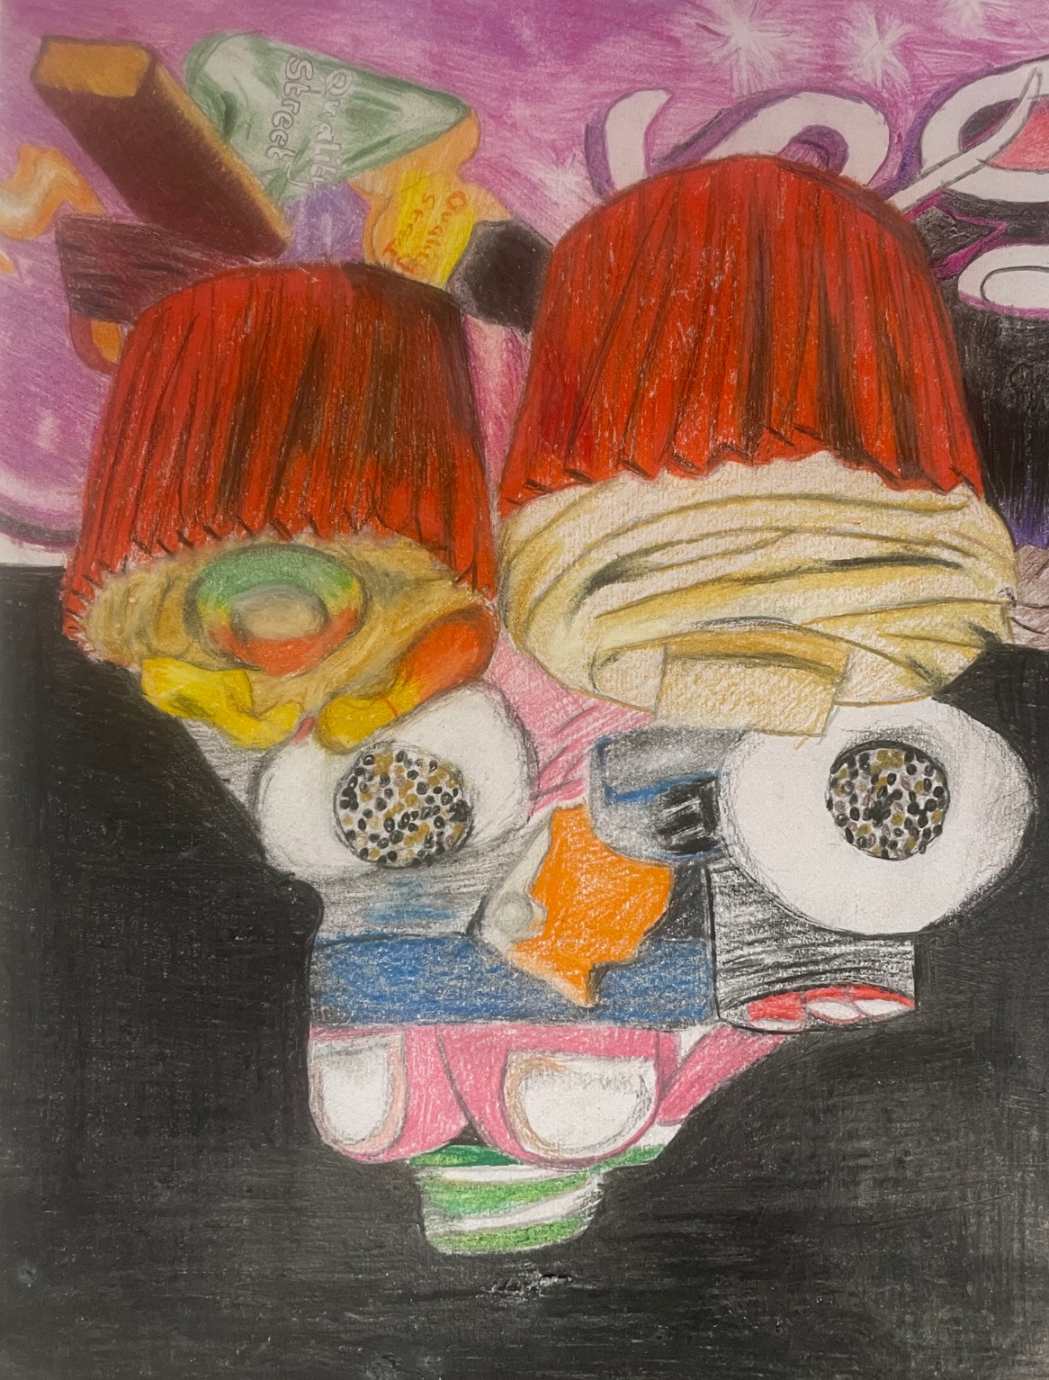
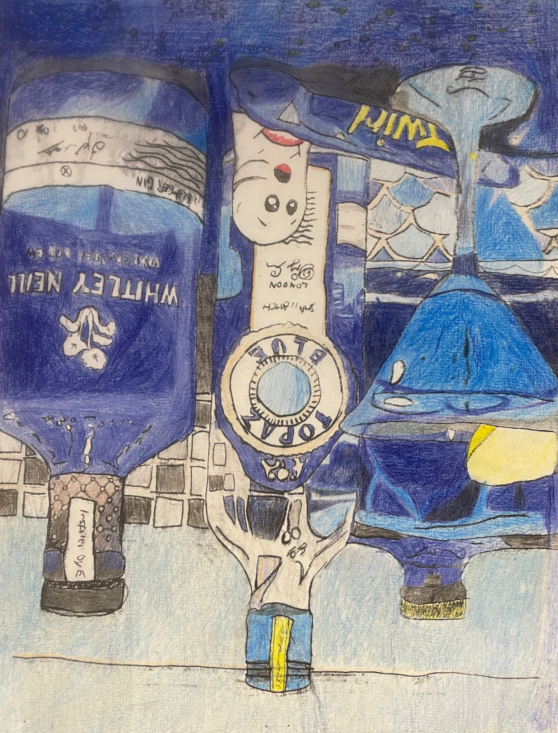
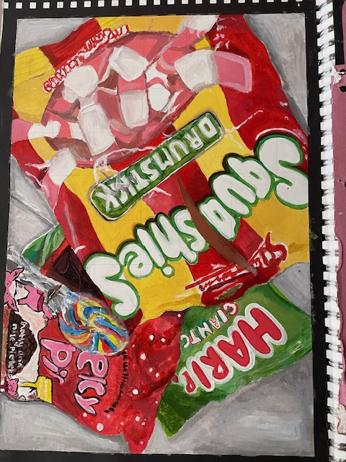
Drawing and Painting

Slide 12
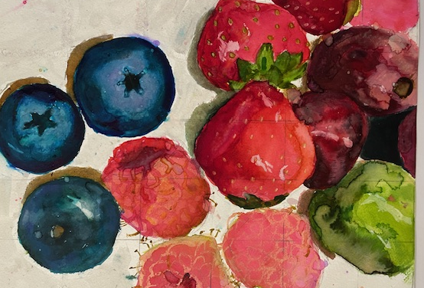
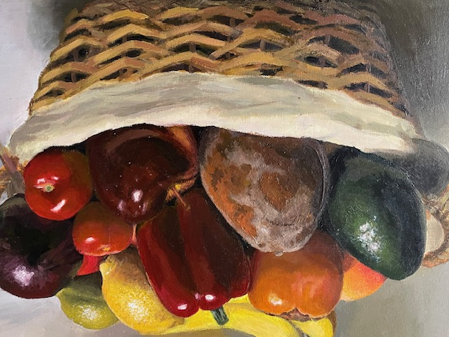
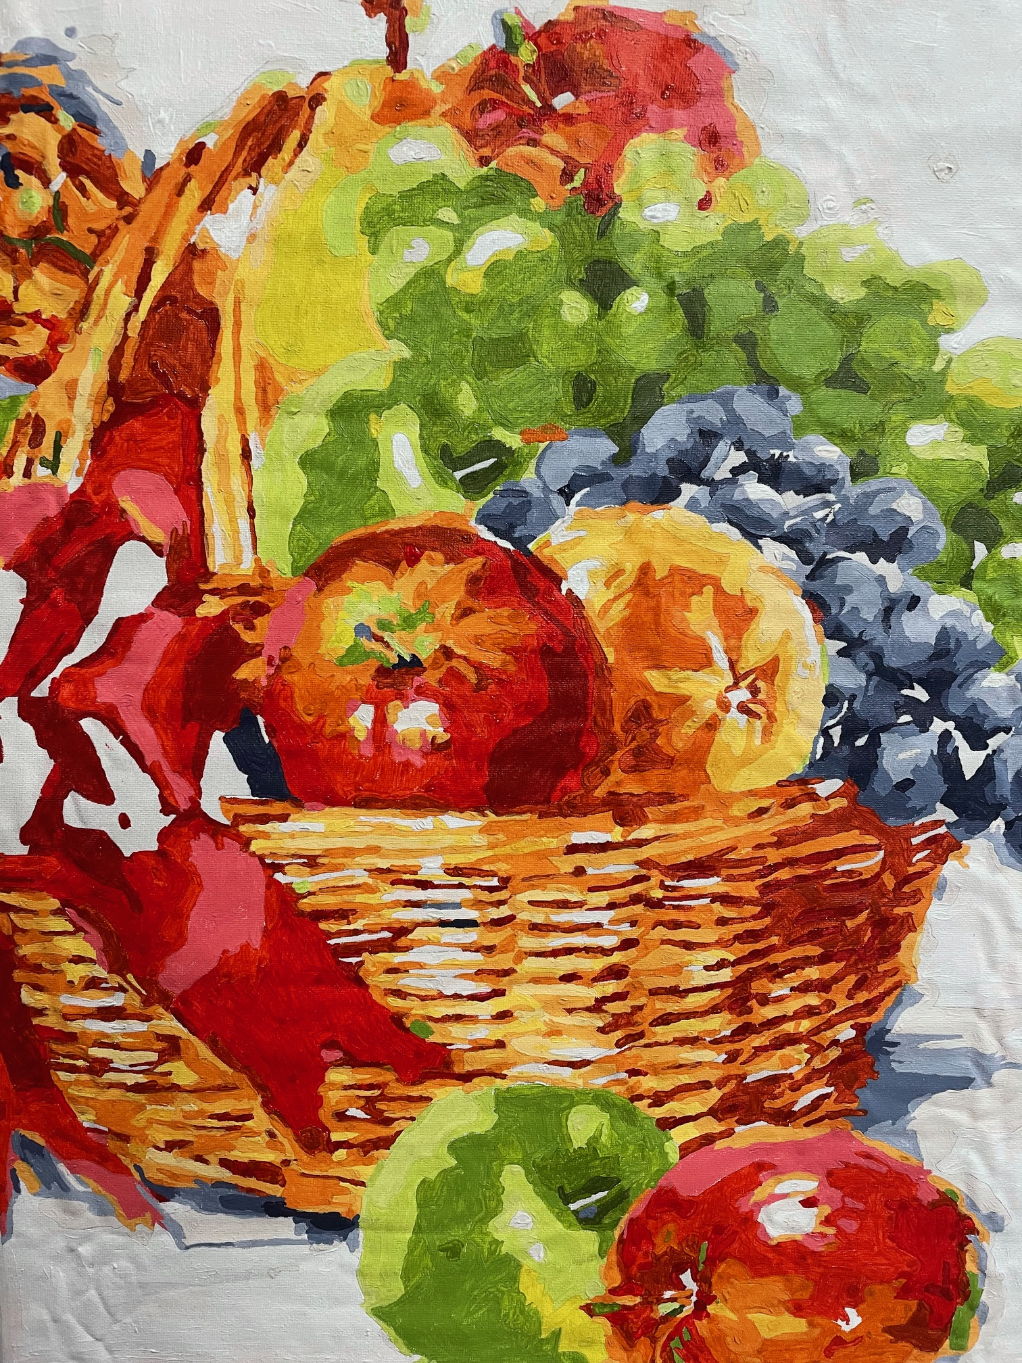
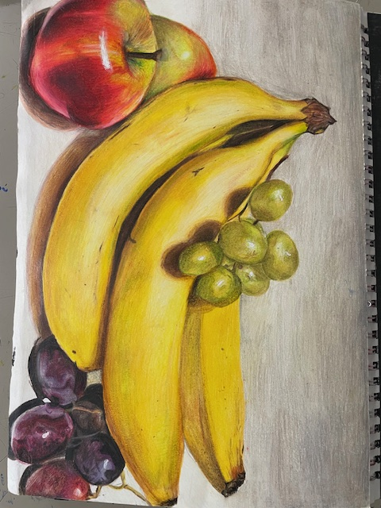
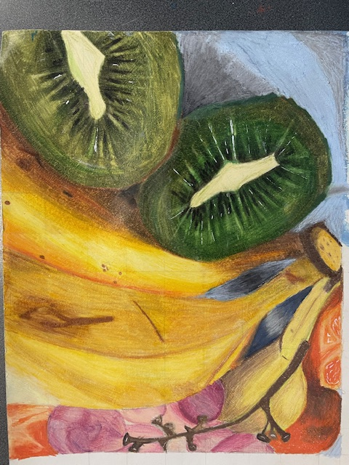
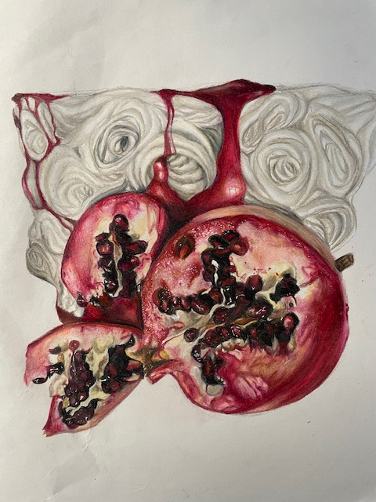

Slide 13
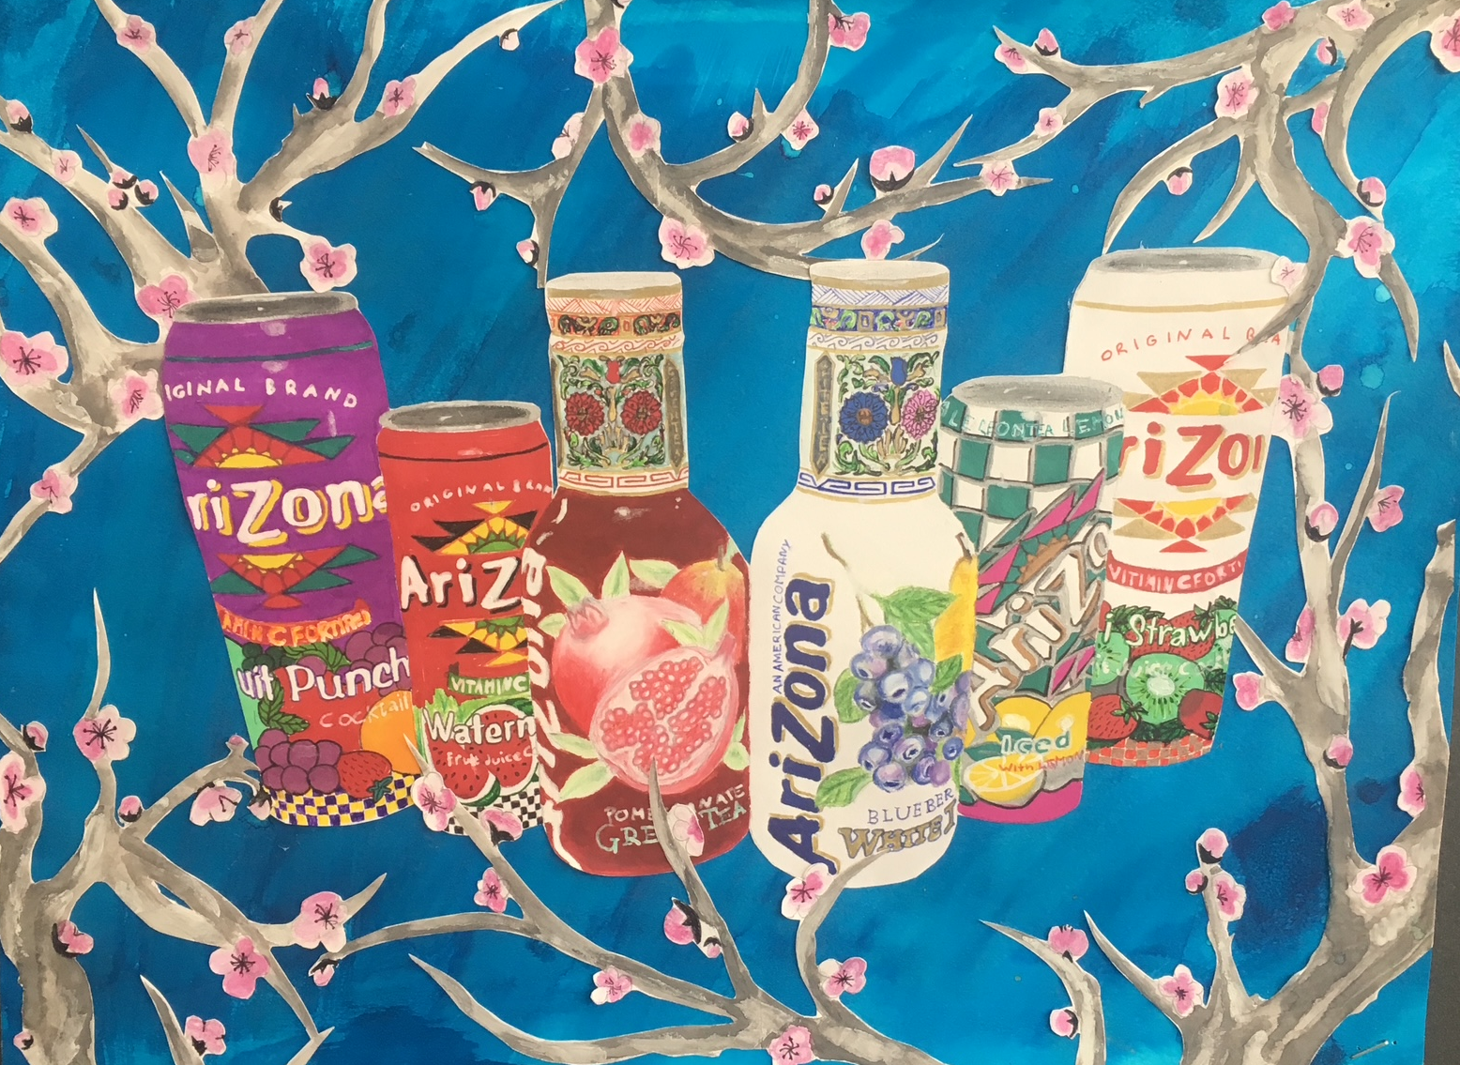
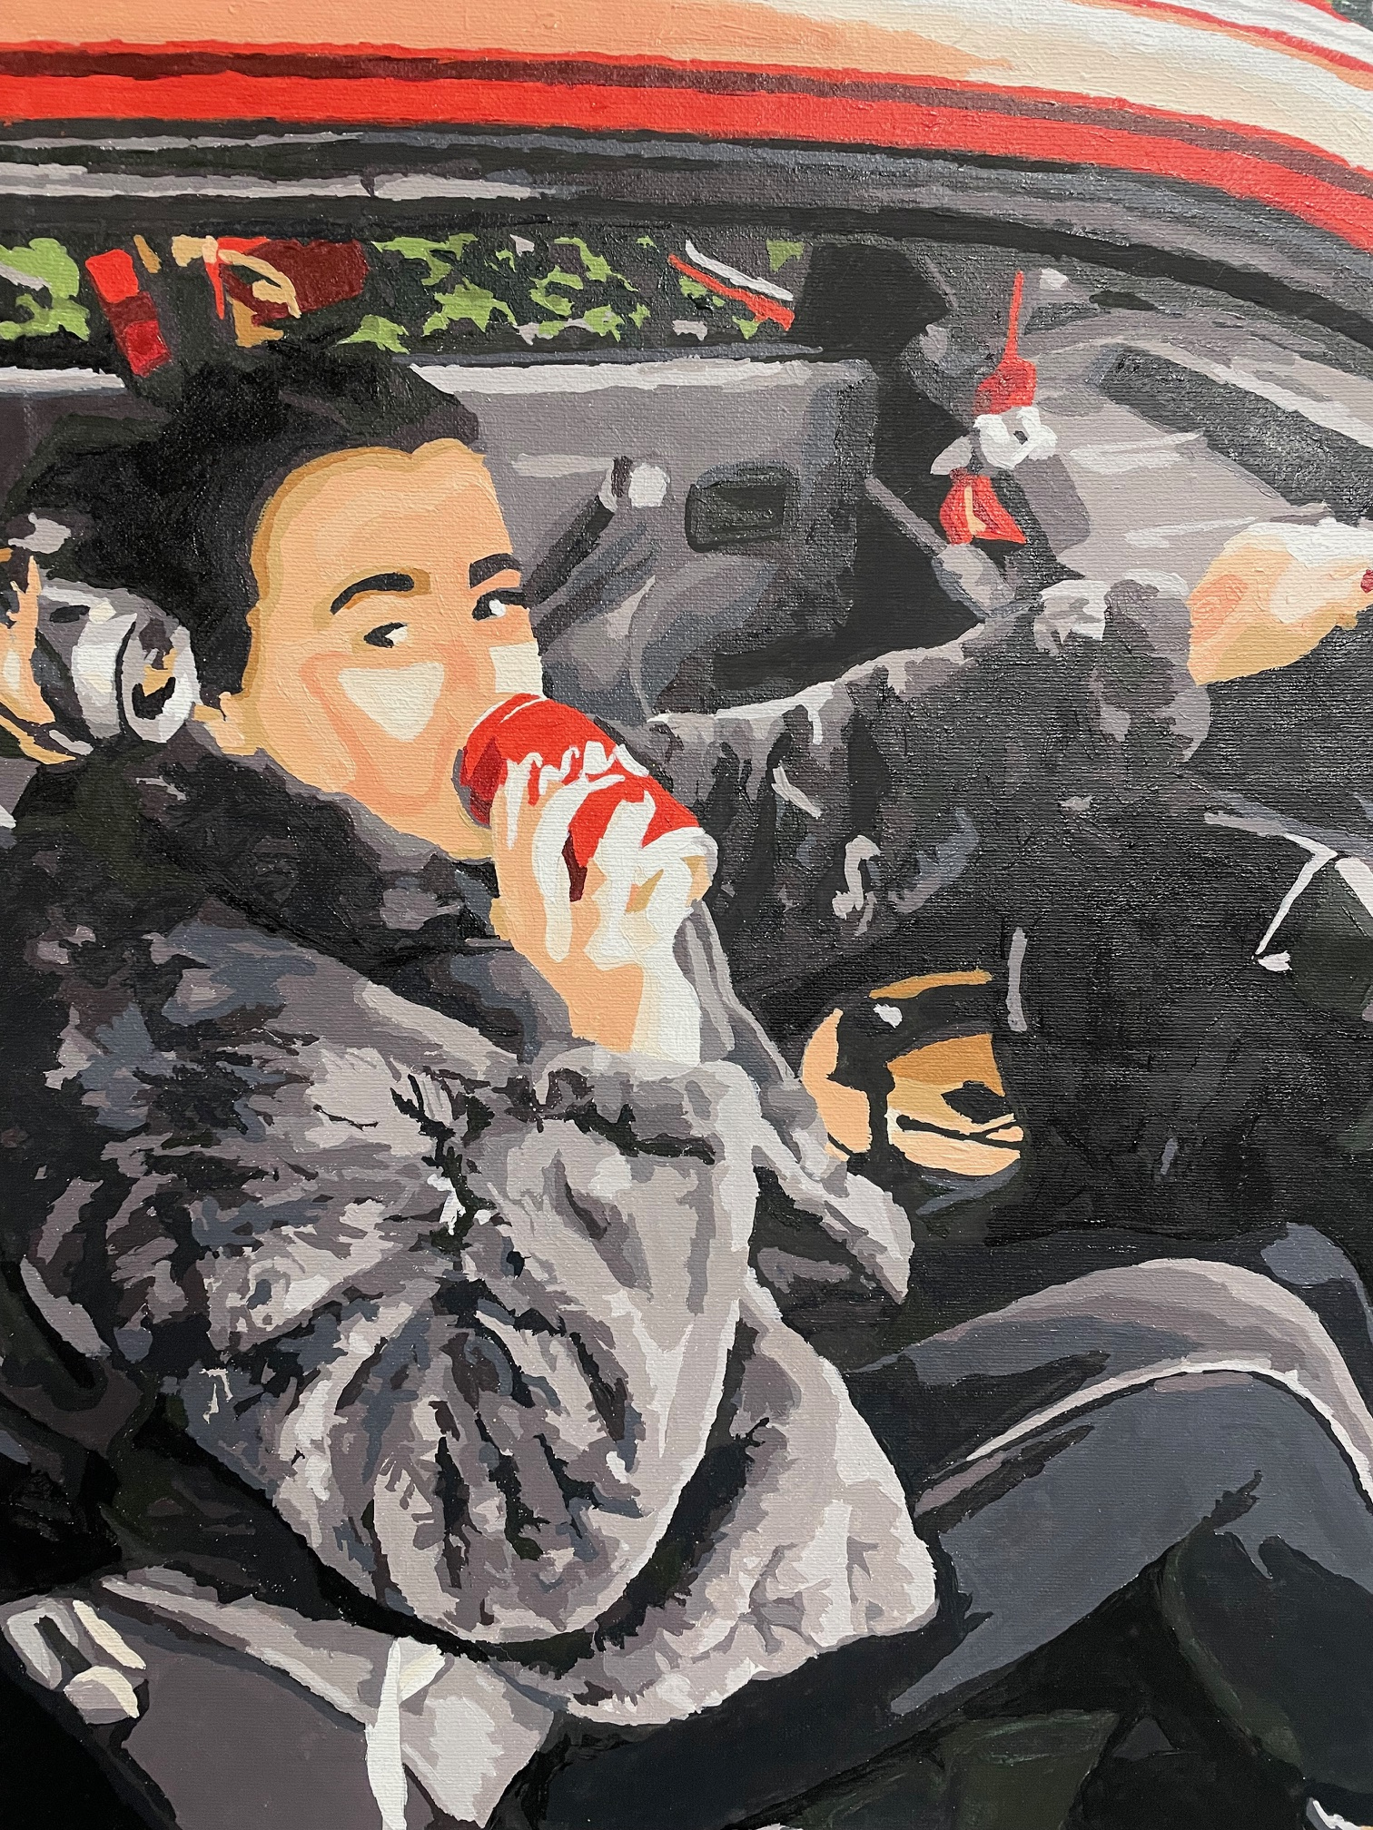
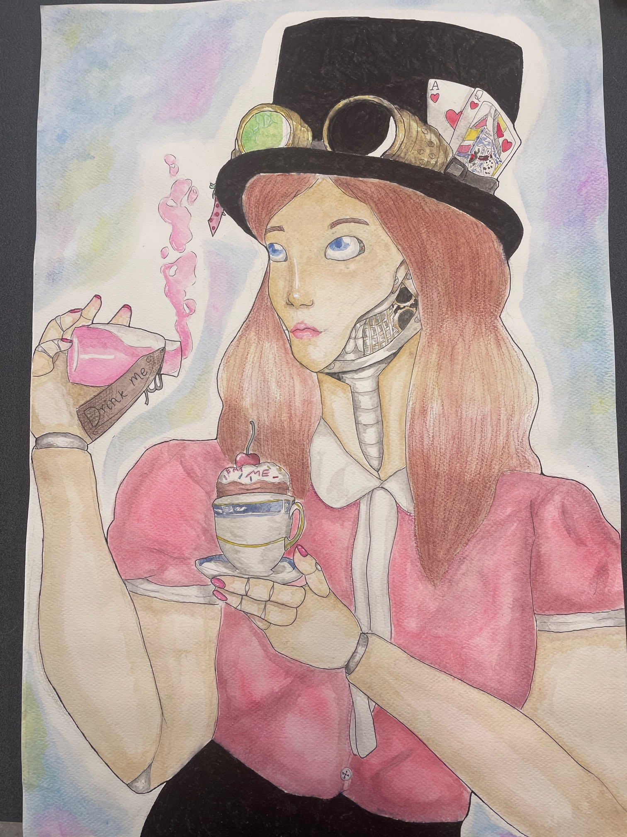
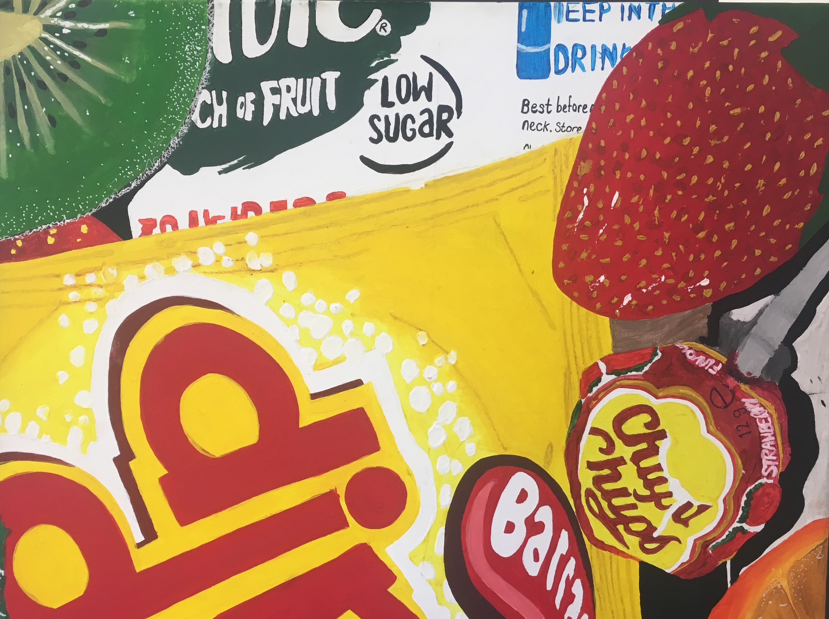
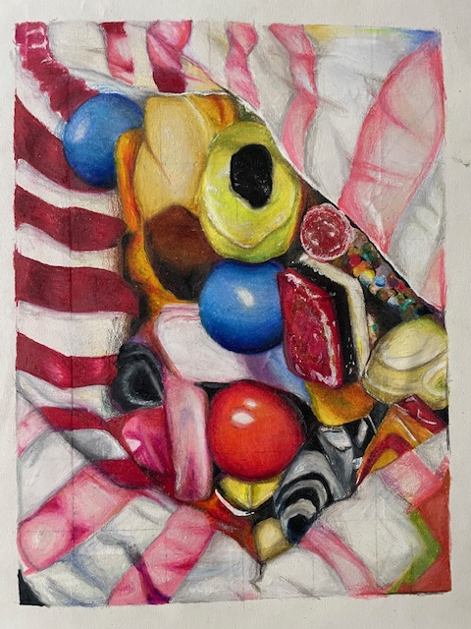

Slide 14
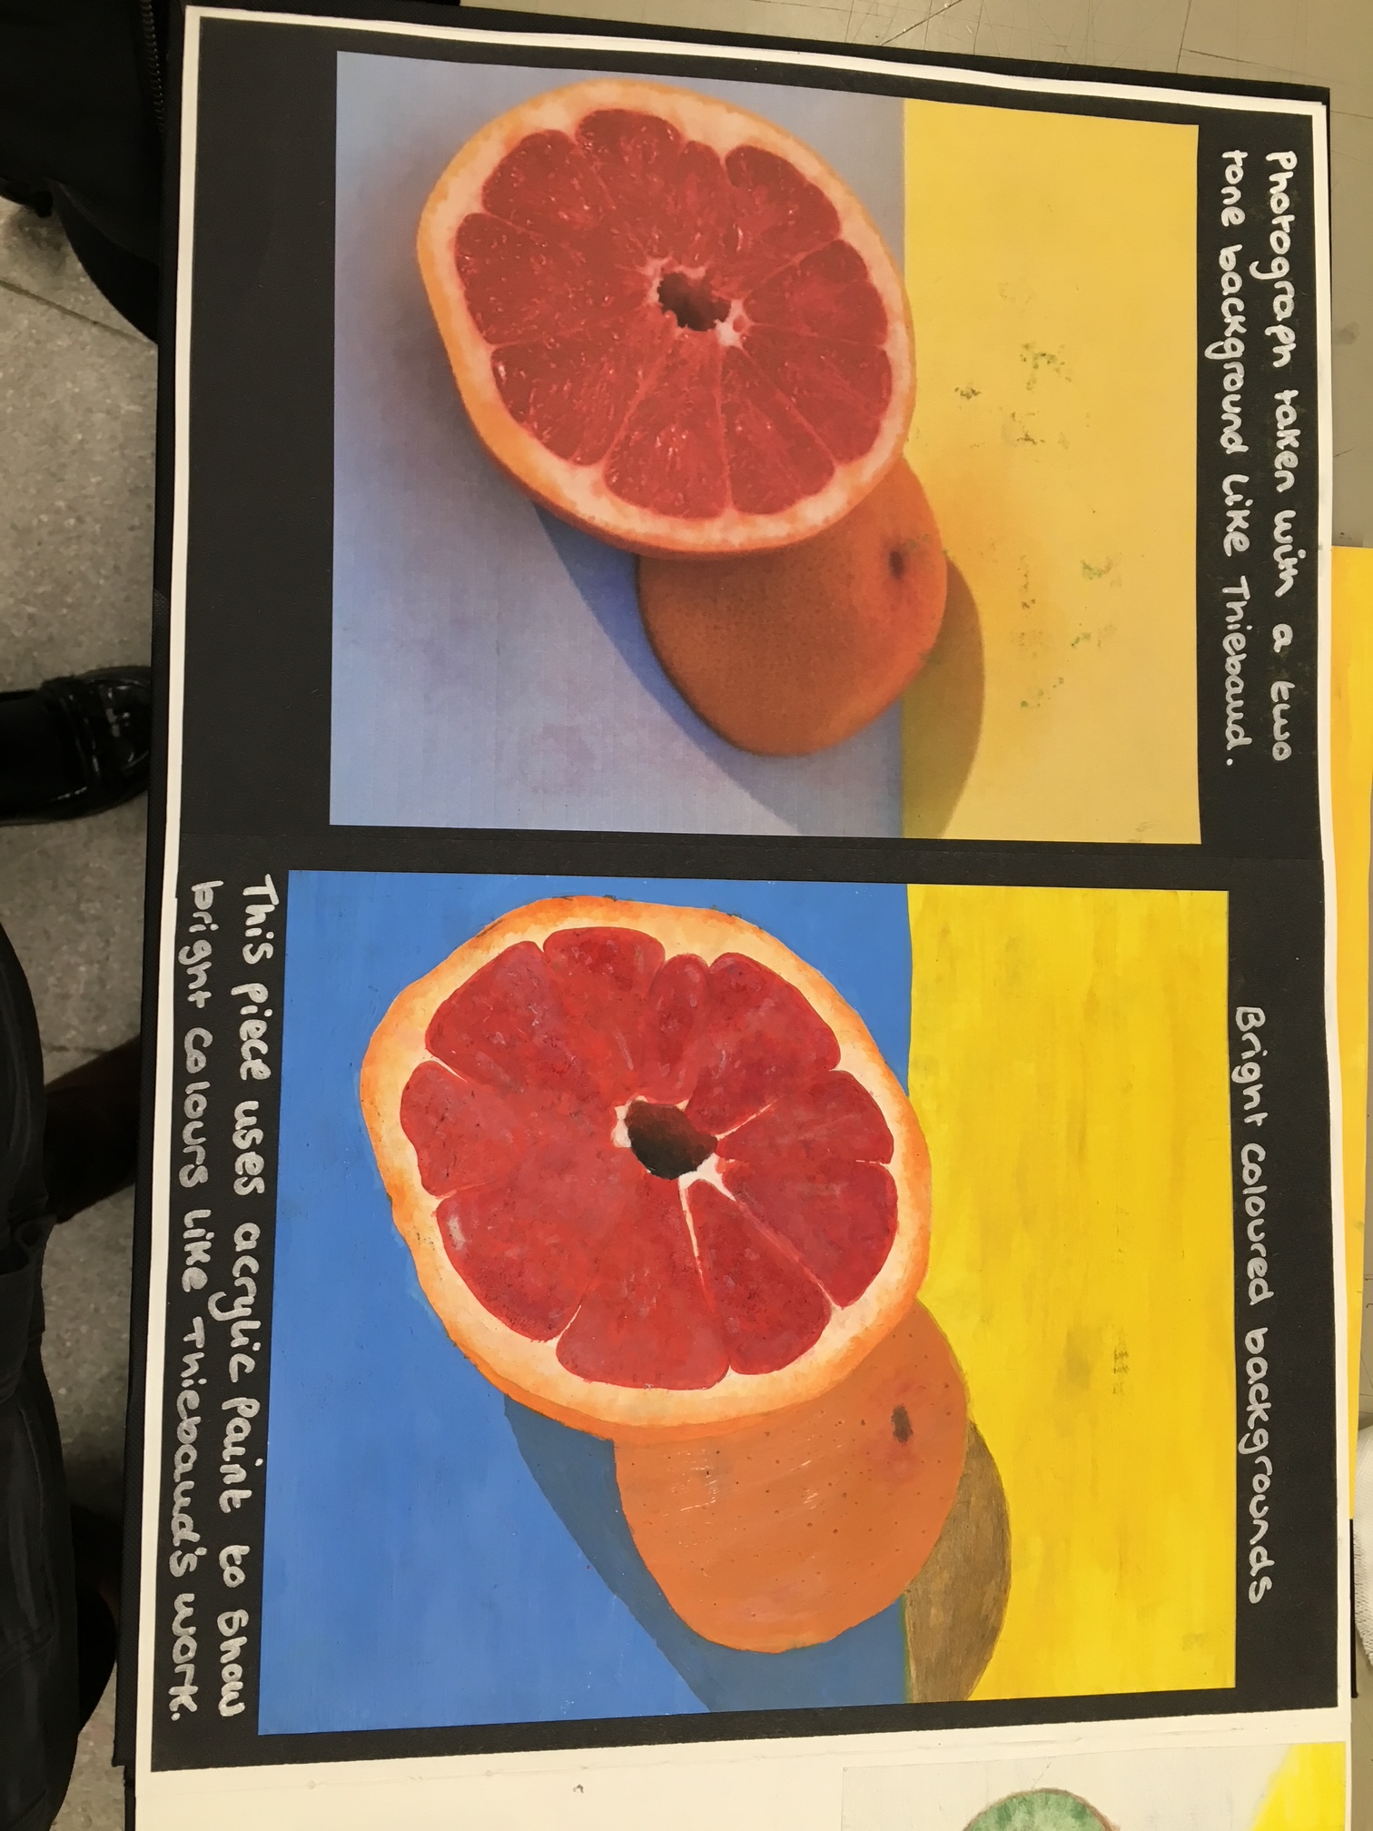
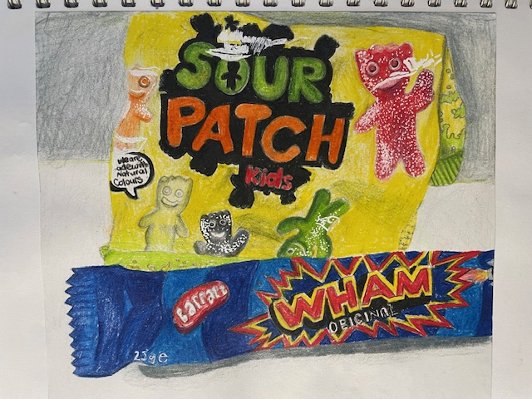
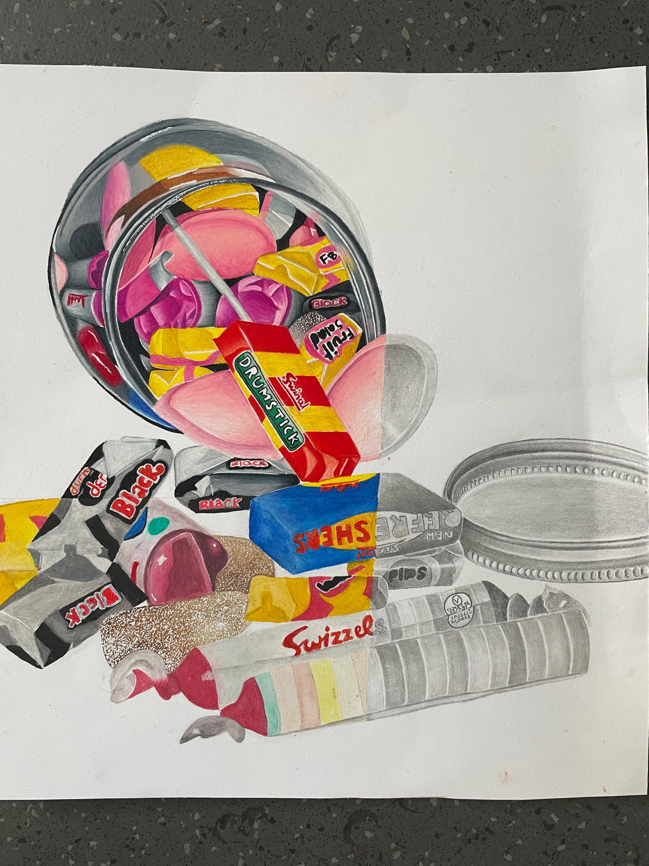
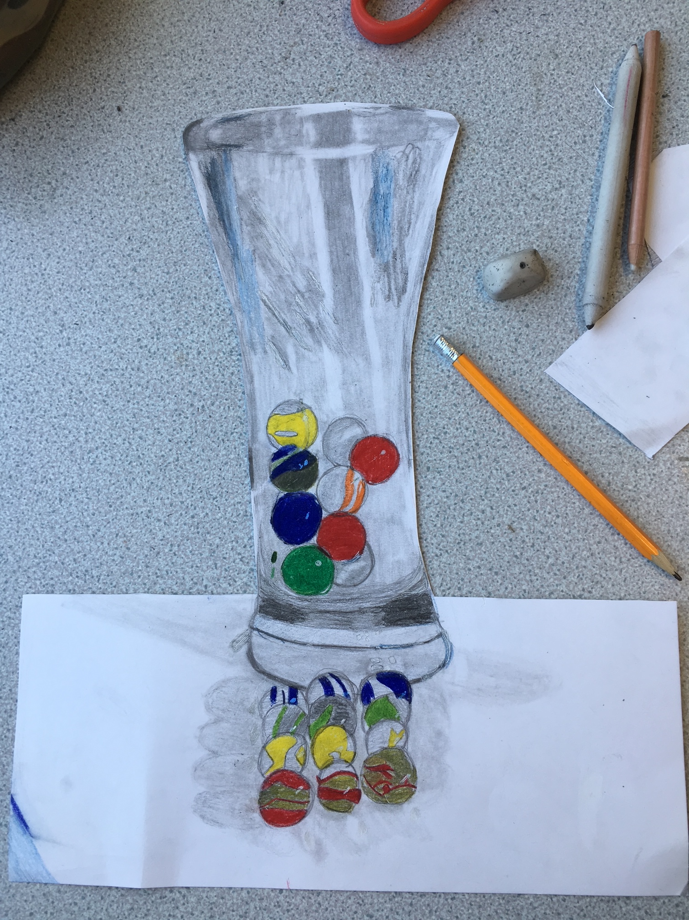
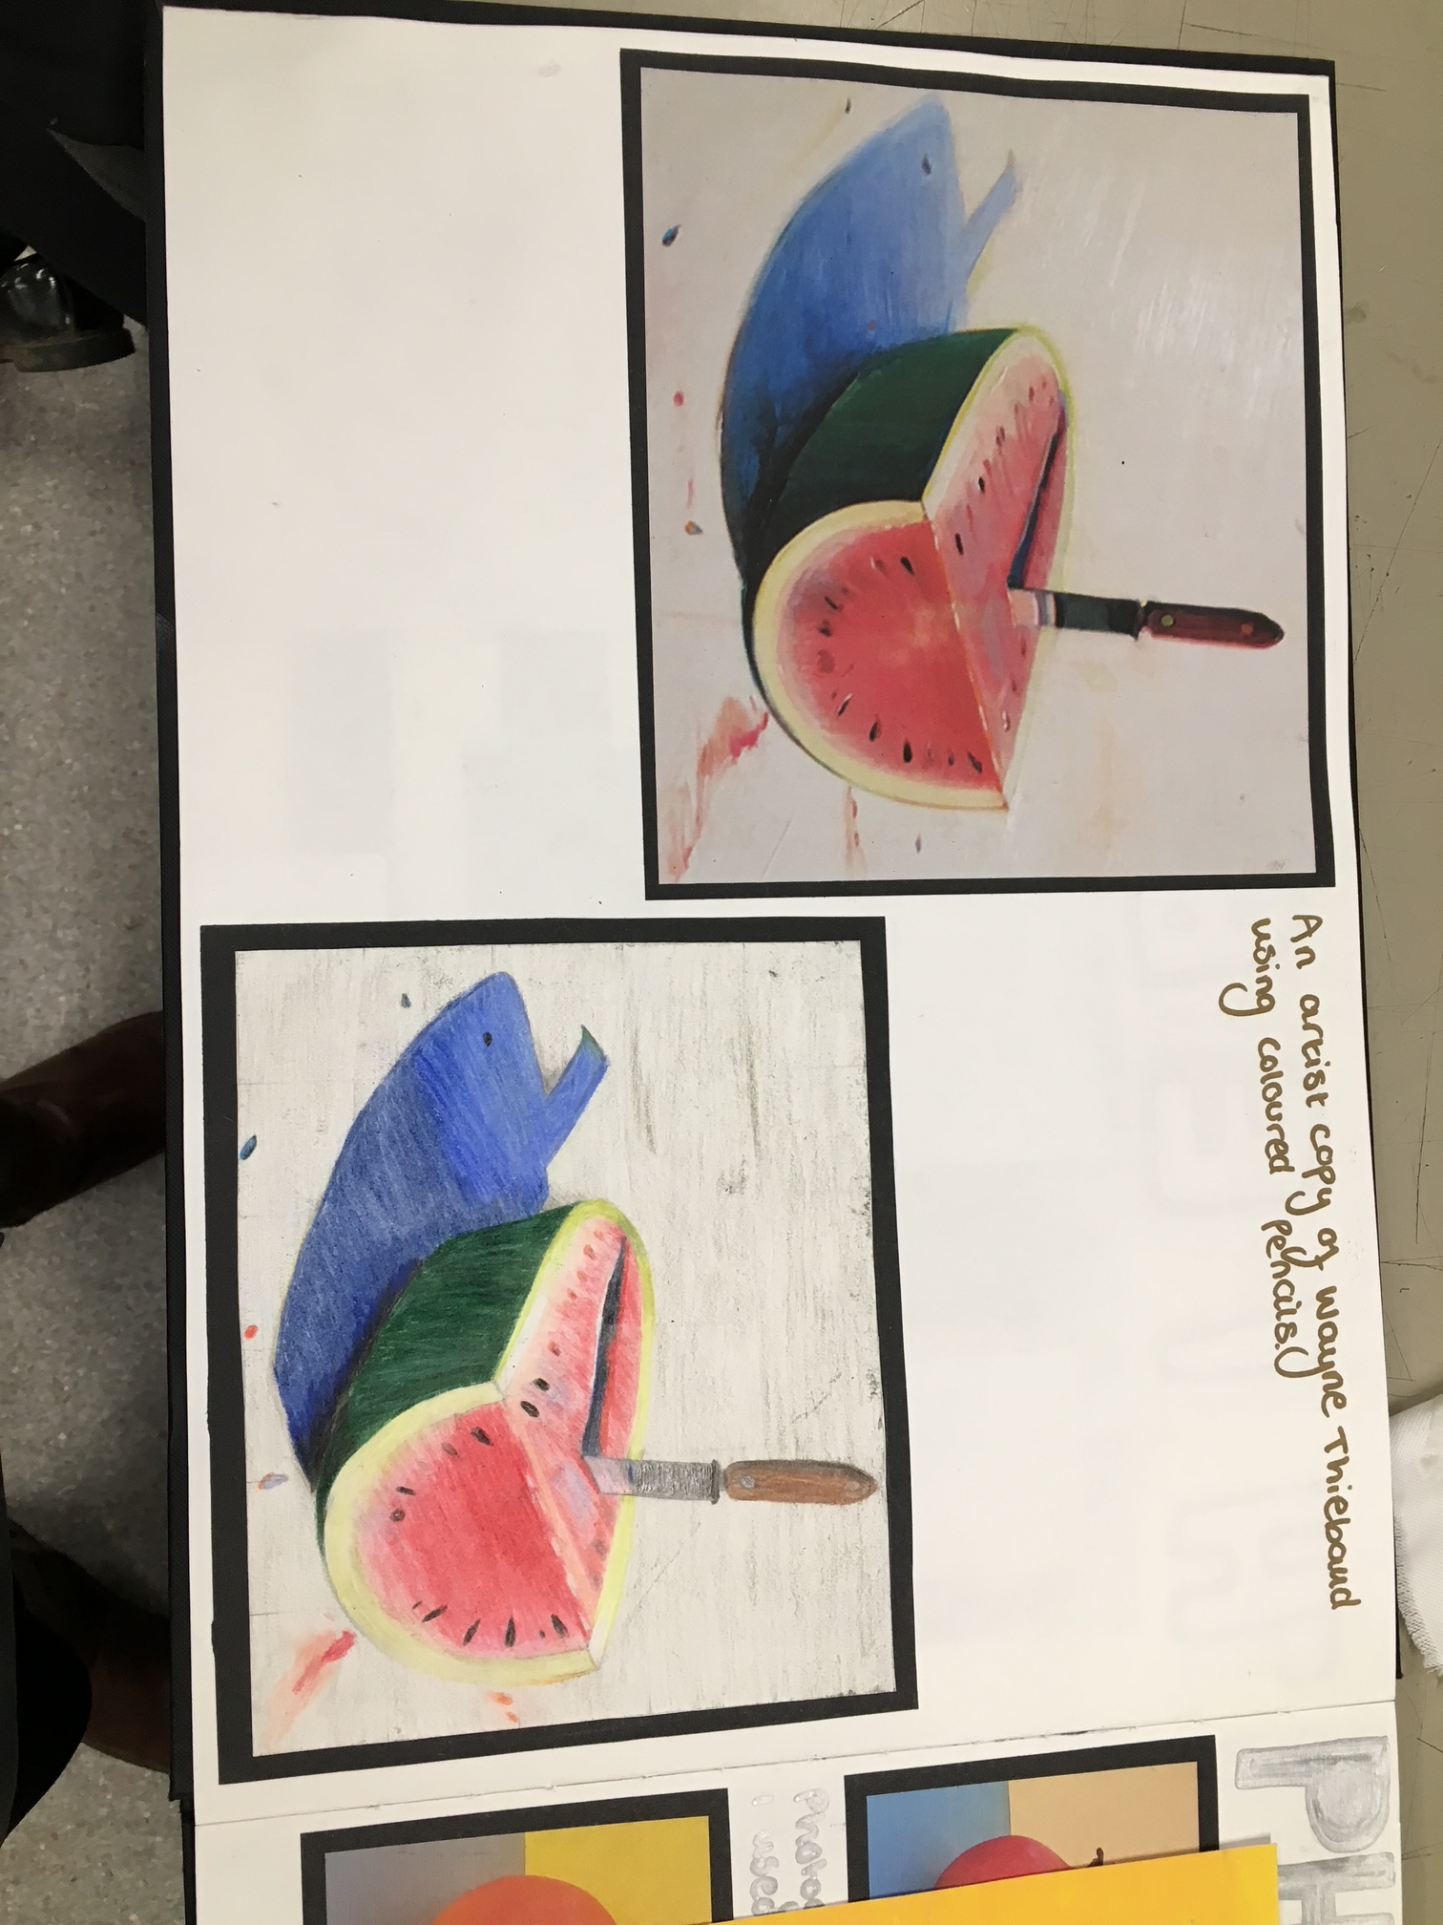

Slide 15
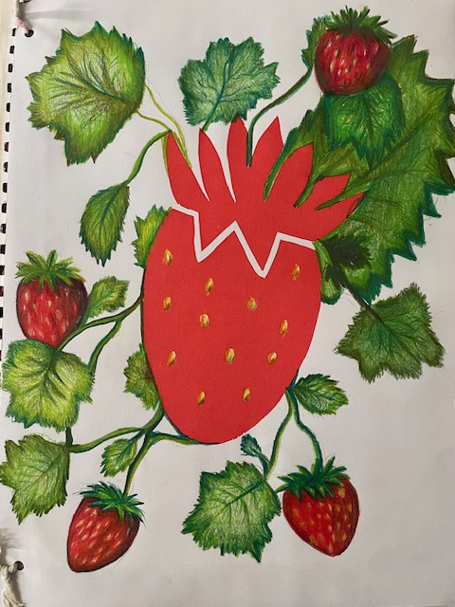
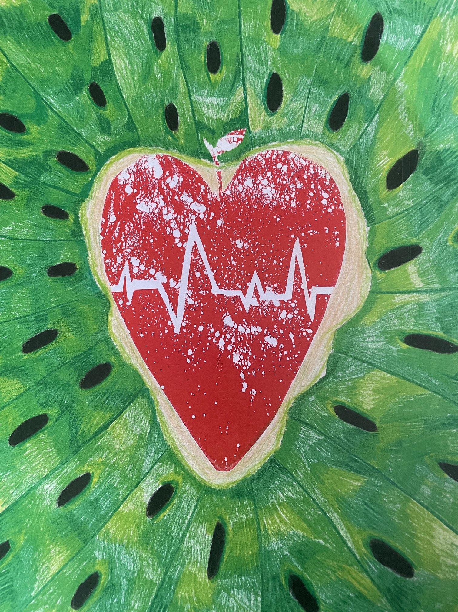
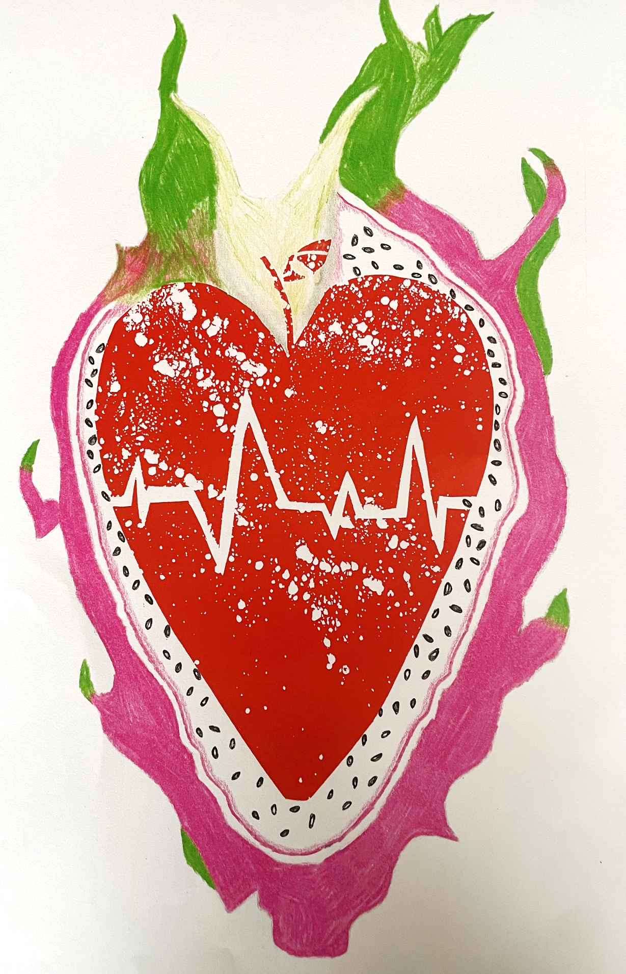
Screen Printing

Slide 16
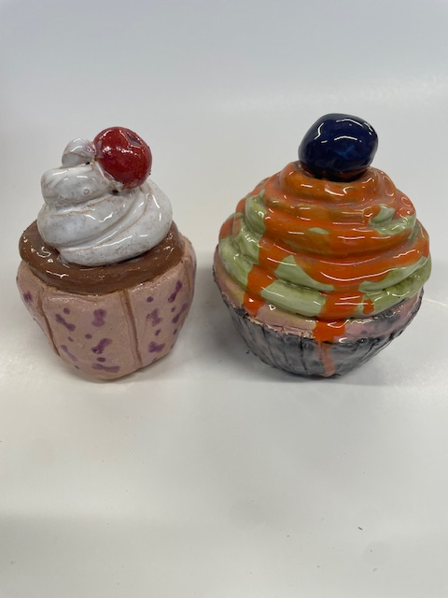
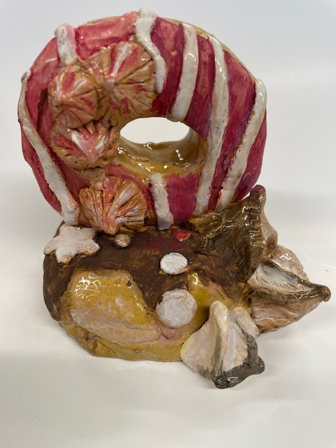
Ceramics

Slide 17
January of Year 11 to Easter Component 02 40% of the overall GCSE grade
Externally set task: Students respond to one of five themes, each supported by a range of written and visual starting points and artists. Students produce a body of preparatory work to develop their ideas, which they then respond to during a ten-hour supervised period under exam conditions.
Current Paper

Slide 18
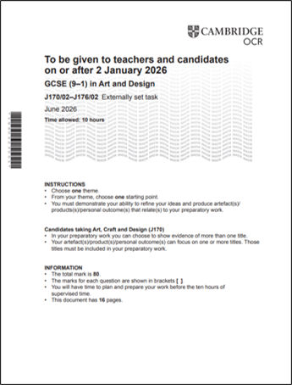
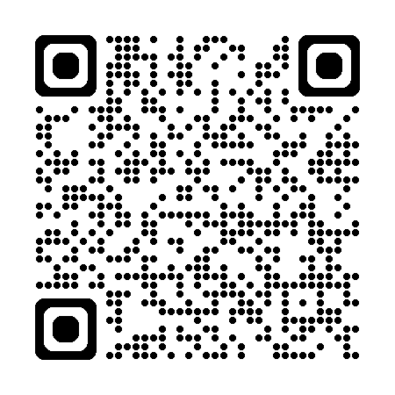

Slide 19
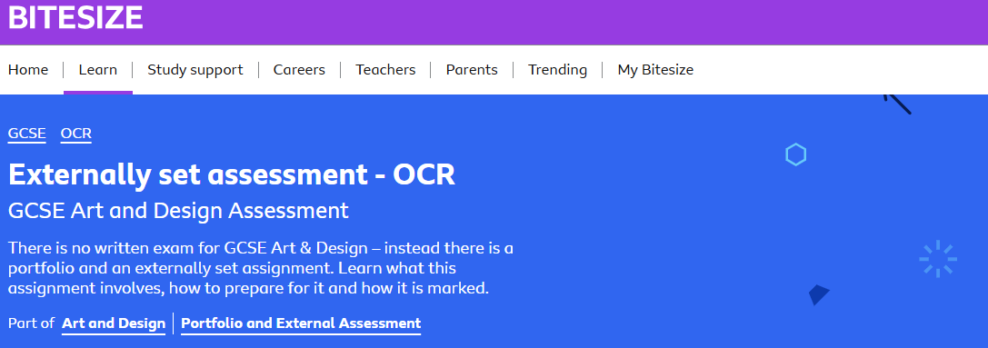

Slide 20

Skills You’ll Gain: Creativity, visual communication, independence, problem-solving, and design thinking—valuable in many careers!
Fine Art & Studio – Painter, Illustrator, Sculptor, Curator, Art Conservator.
Commercial & Marketing – Advertising, Set/Costume Design, Media Illustration.
Career Pathways from
GCSE Art & Design
Design & Applied Arts – Graphic Designer, Fashion/Textile Designer, Product or Jewellery Designer.
Education & Community – Art Teacher, Community Arts Worker.
Media & Digital – Animator, Game Designer, Photographer, Web/UX Designer.
Industrial & Engineering Design-Automotive Designer, Packaging Designer, Exhibition Designer, Product Engineer
Architecture & Environment – Architect, Interior or Landscape Designer.

Slide 21
No Traditional Exam: Unlike history or math, there is no final written exam paper.
The Portfolio (60%): A collection of work produced over the two years (Year 10- Jan Year 11), showing a journey from initial ideas to final pieces.
The Externally Set Assignment (40%): A project set by the exam board, where students select a starting theme, research it, and create a final piece under timed conditions.
The Four Assessment Objectives (AOs)
Develop Ideas (AO1): Looking at other artists and taking inspiration from them.
Experiment (AO2): Trying out new materials and techniques.
Record (AO3): Drawing, photographing, and sketching from real-life objects.
Present (AO4): Creating a final, finished piece that links all the research together.

