Slide 1



Why study history?
Ms Mottershaw and Mr Moore

Slide 2
How can GCSE history help you?
We all live in a volatile, dynamic and interconnected world. Knowledge of the past is essential in understanding and trying to make sense of what’s happening now.
GCSE History helps us to do both, through studying key events and individuals from the past and the ways in which they have shaped our present.
Employers are always looking for young people who are able to think critically and analytically, both key attributes of the historian, and studying GCSE History can help you take the first steps on a variety of career paths, including law, journalism, marketing, human resources, and management.
GCSE History also serves as a platform for further study at A level and undergraduate level, either in history itself or in a wide range of alternative disciplines.
It can act as the foundation stone for education of all kinds and helps develop academic skills crucial in a range of fields.
These include:
the ability to absorb large quantities of information
sift content
analyse sources and interpretations
shape arguments and reach balanced conclusions.
Above all, though, GCSE History provides a highly interesting and stimulating course of study, allowing the investigation of a wide range of periods and societies in the past at international, national and local level.

Slide 3
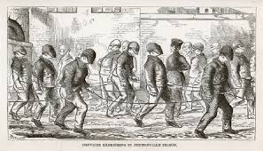
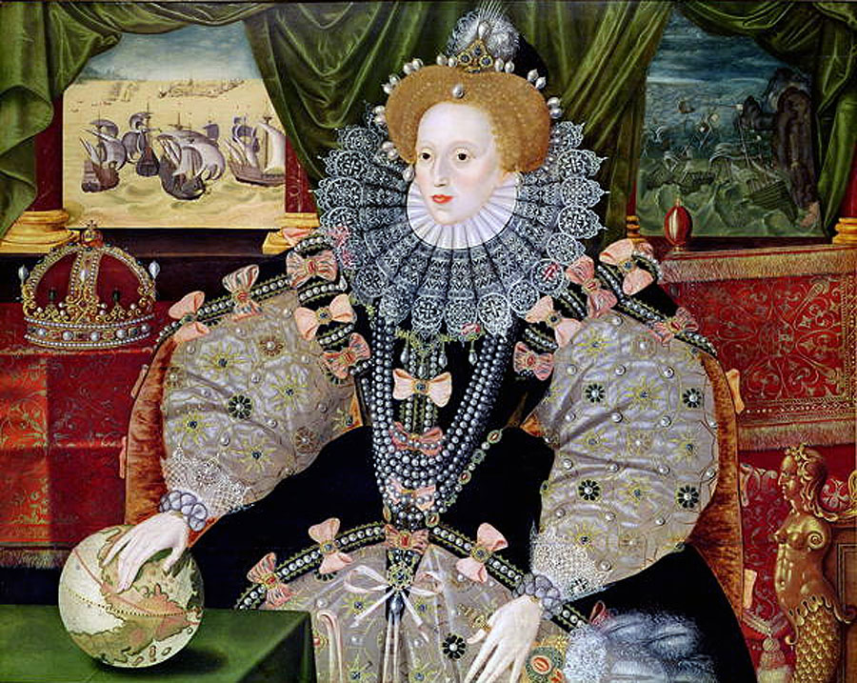

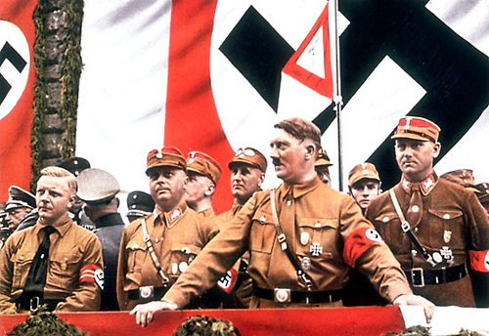
What will I study?
4 units:
Elizabethan England
Germany in Transition
USA in development 1929-2000
Crime and Punishment 500c-present day

Slide 4
How will I be assessed?
2 two hour exams.
Paper 1
Elizabethan Age (1 hour)
Germany (1 hour)
Paper 2
Crime and Punishment (1hr 15 mins)
USA (45 mins)

Slide 5
What skills will I develop?
GCSE History is the perfect subject to develop and assess a wide range of transferable skills for employment or further study
Reaching conclusions and making judgements
Problem solving
Writing skills
Research skills
Independent study skills
Analytical and evaluative skills
Making connections

Slide 6
What could I do with my qualification?
GCSE History is a great basis for many A level subjects and it is highly regarded by colleges, universities and employers.
Students who have studied history often study A Level qualifications in subjects such as English, politics, economics and sociology
. Some students enjoy it so much they carry on with it even if they are studying maths or science subjects.
Many people working in law and accountancy have studied history because of the skills that can be developed in reasoning and arguing your point.
There are also many areas more directly related to history, such as travel and tourism, museums and libraries, the media industry, government research and, of course, history teaching.

Slide 7
Trip opportunities
Visit to Poland (Auschwitz)
London Dungeons or Blackpool Dungeons
Clink prison
Ruthin Gaol
Little Moreton Hall – Elizabethan Manor house
Hampton Court
Shrewsbury Prison
Thanks for listening, if you have any questions, please attend the forum 10th February and/or complete the online questionnaire to guide us on the sort of questions you would like answering.
Notes:
These are dependent on many factors, but they are trip we would like to run!

